Slide 1
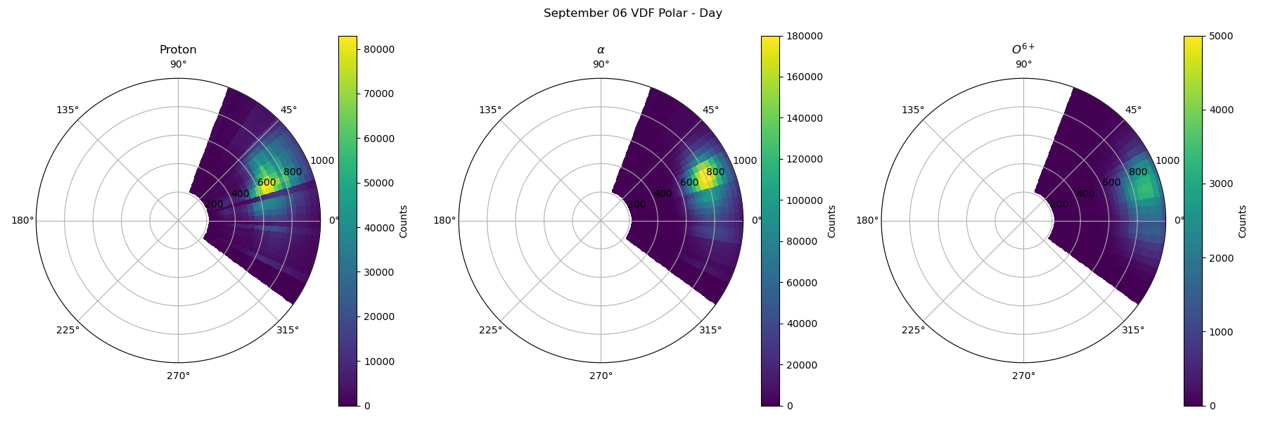
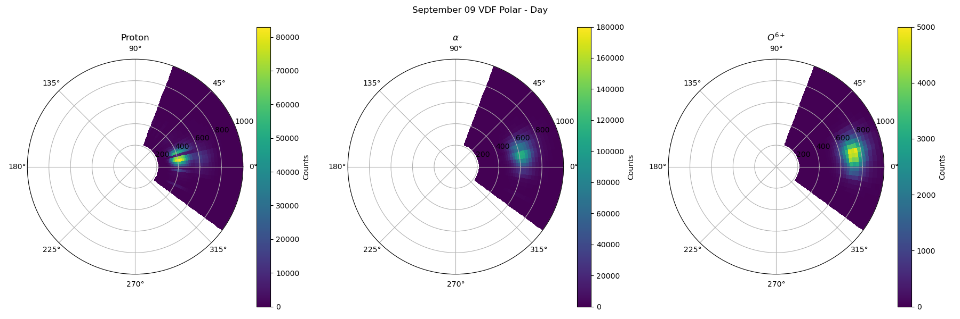
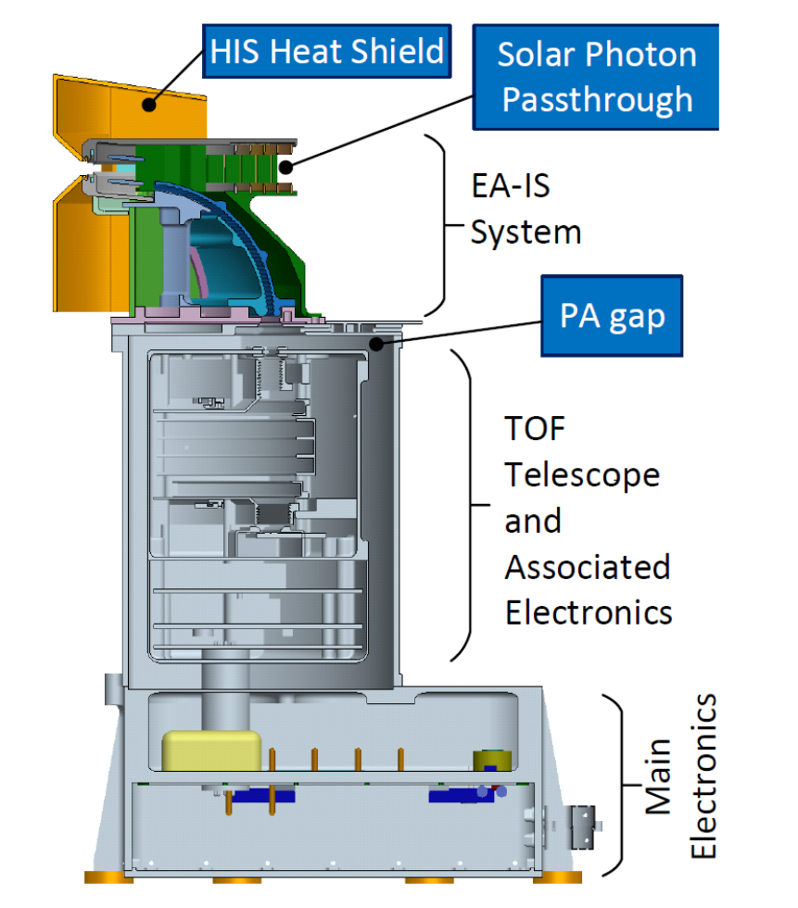




Calibration of the Heavy Ion Sensor 3D Velocity Distribution Functions
Tyler Eddy¹, Aidan Nakhleh¹, Ryan Dewey¹, Susan Lepri¹, and Jim Raines¹
¹University of Michigan
Abstract
The Heavy Ion Sensor (HIS) is a time-of-flight plasma spectrometer onboard Solar Orbiter that measures the heavy ion populations (e.g., C, N, O, Ne, Mg, Si, S, and Fe) and their charge state distributions between 0.5- 75 keV/e. The velocity distribution functions (VDFs) of heavy ions carry critical information pertaining to anisotropies with respect to the magnetic field that lead to instabilities that determine the different energy exchange processes found within the fast and slow solar wind. To date, 3D VDFs of heavy ions have never been resolved in the solar wind. We present our ongoing efforts to calibrate the HIS VDFs of protons, helium, and, for the first time, oxygen ions within the solar wind. The processes developed will provide the pipeline for future production of heavy ion VDFs measured by the Heavy Ion Sensor.
The Heavy Ion Sensor (HIS)
The Heavy Ion Sensor (HIS) is part of the Solar Wind Analyzer (SWA) instrument suite measuring in situ plasma and energetic particles in the solar wind. HIS is a triple-coincidence time-of-flight mass spectrometer containing a spherical top hat electrostatic analyzer, time-of-flight chamber, and solid-state energy detectors. By convolving the measurements taken from the system (E/q, v, & E) the mass and charge state of heavy ions are determined. In addition, the angular separation along the aperture of incoming ions is preserved through ion optics to provide the velocity distribution. Since the Helios mission critical observations have made of proton and helium VDFs, however, the heavier, trace elements have yet to be measured. HIS will provide these distributions and enable the investigation of longstanding science questions such as the source of differential streaming between heavy ions and the mass-per-charge dependence of various heating processes generated by perturbations the ambient magnetic field.
Solar Wind & Transient VDFs
In show the full day accumulated VDFs for September 6th, 2022, when a CME passed by Solar Orbiter and during September 9th, a few days later during a relatively quiet period. It is clear from both data sets that there is approximately 50 – 100 km/s differential streaming between the heavier and lighter ions. In addition, on September 6th, during the CME is there is a large increase in alpha particles and clear indications of a diffuse, heating oxygen population.
Calibration Process
Data collected by the Heavy Ion Sensor (HIS) is binned according to dimensions of its measurements (E/q, θ, ψ). First, voltages applied to the deflector plates at the entrance yield a range 34° over 16 elevation (θ) steps. Second, the electrostatic analyzer cycles through 64 voltages to provide an energy-per-charge (E/q) bandpass filter between 0.5 and 75 keV/e. Finally, the angular acceptance preserved through ion optics are transmitted onto an array of 32 solid-state detectors providing the bins over a 99 ° range. This 64 ×16×32 data structure must then me transformed through SPICE kernel rotations from the instrument reference frame, to the spacecraft reference, and eventually into heliocentric coordinates. The fidelity of the bin sizes are iteratively improved through a combination of ion optical simulations of instrument performance, in-flight calibration techniques, and statistical analysis to provide finer resolutions for each data release.

