Slide 1

Flux Ropes &
their Dynamics
Which processes influence the geo-effectiveness of flux ropes?
How do the magnetic topology and stability of flux ropes evolve during their propagation?
How can we reproduce the magnetic topology of the flux ropes?
Organisers: Fernando Carcaboso, Teresa Nieves-Chinchilla, Sanchita Pal, Carlos Braga
Scene setting: Erika Palmerio

Slide 2
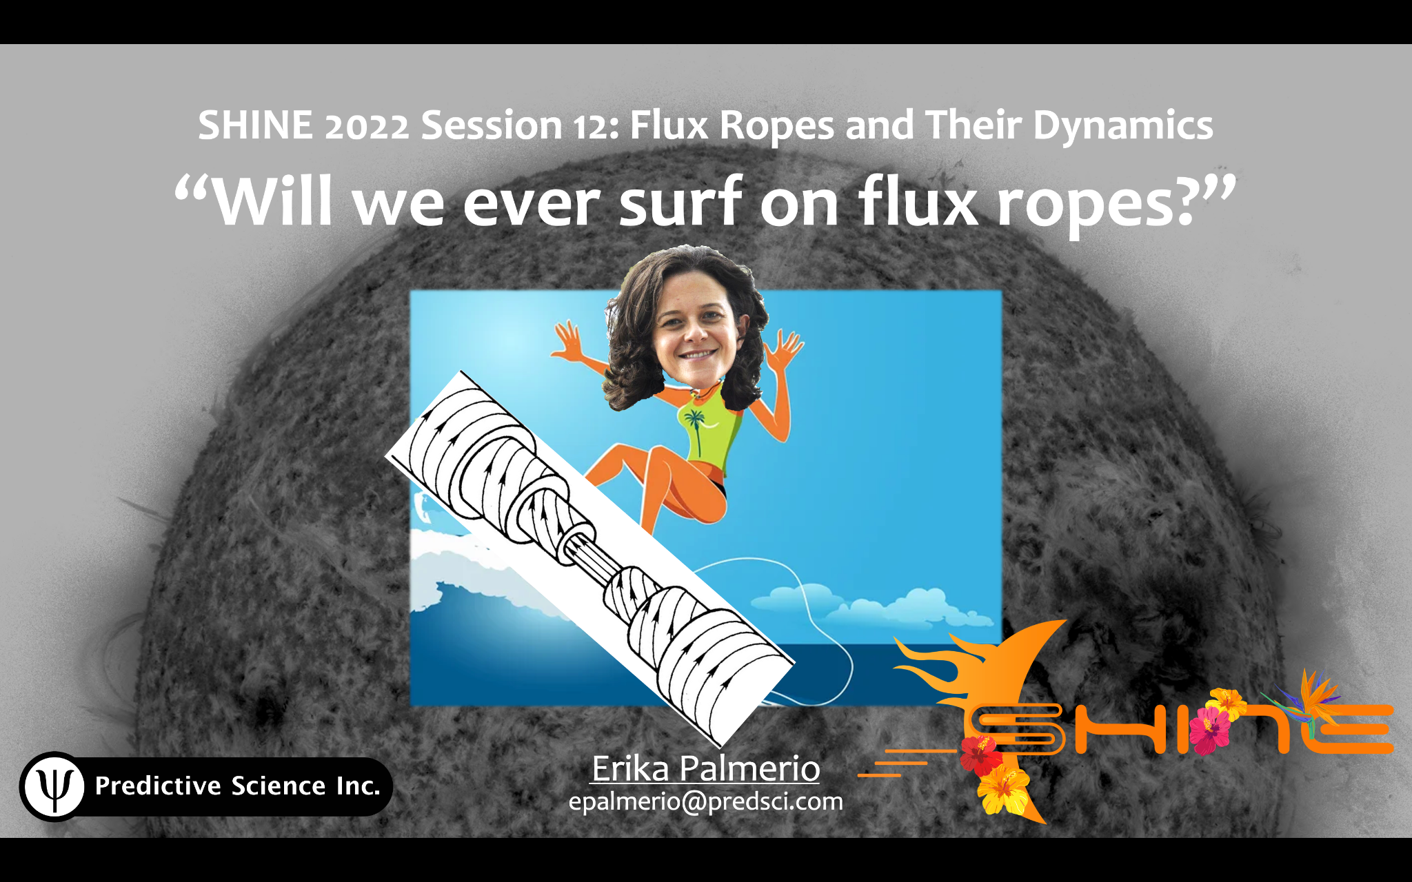

Slide 3
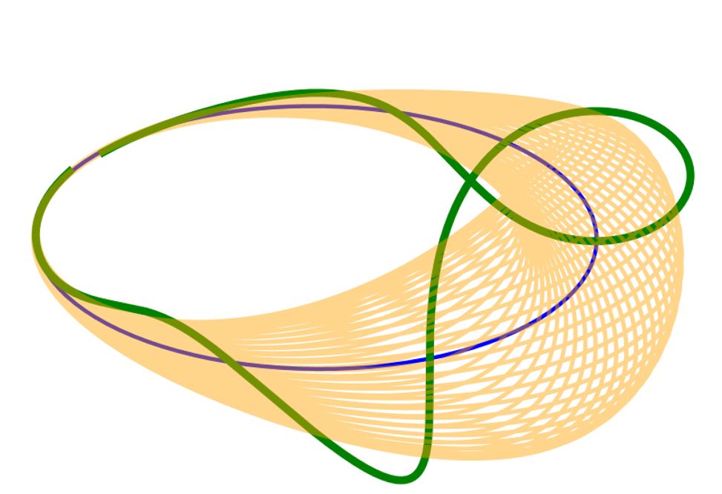


Block 1
Flux ropes at the Sun and in the corona
LUNCH BREAK
Block 2
Flux ropes in interplanetary space
20 min
Jump-in
presentations
11:15
12:30
14:00
15:15

Slide 4
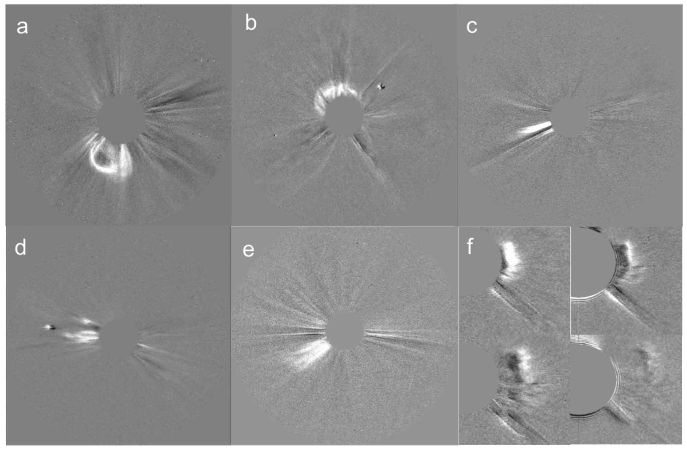

Block 1 - Derived questions
• Do we need to find a magnetic
topology for CMEs that explains
all observations?
• Different types of CMEs: loops, flux ropes, jets, waves, others. The interplanetary counterparts of jets and waves are not well known.
• Are projection effects responsible for some CMEs not having the different parts that they “should” have?
• Is it all related to the point of view? Lack of reference after STEREO-B is lost. • Linked to previous session (#13) How can we improve our current understanding of the nature of pre-eruptive configurations and the genesis of solar eruptions?
Block 1
Flux ropes at the Sun and in the corona

Slide 5
Block 2 - Derived questions
• How do flux ropes evolve
during propagation?
• How do we best reproduce the magnetic structure of flux ropes? Should we focus on simpler or more complex models?
• Flux rope propagation: Do we focus on simpler models and parameter studies, or do we try to get things as real as possible?
• Would things get better with more measurements across the heliosphere?
Block 2
Flux ropes in interplanetary space

Slide 6
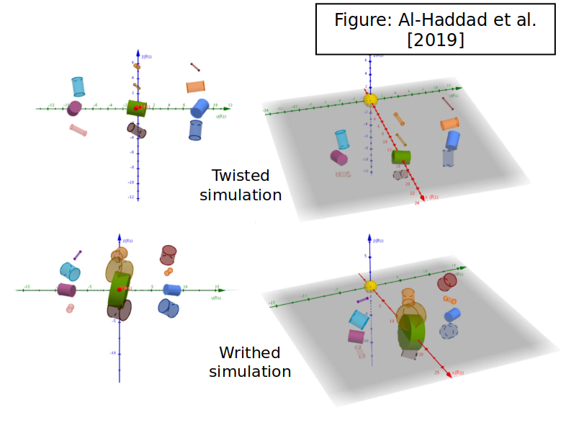
Block 2 - Derived questions
• How do flux ropes evolve
during propagation?
• How do we best reproduce the magnetic structure of flux ropes? Should we focus on simpler or more complex models?
• Flux rope propagation: Do we focus on simpler models and parameter studies, or do we try to get things as real as possible?
• Would things get better with more measurements across the heliosphere?
Block 2
Flux ropes in interplanetary space

Slide 7
Extra discussions
Oleksiy Agapitov
Switchbacks and appearance of small flux ropes
William Matthaeus
Discontinuities in flux ropes - trapped particles
Jump-in
presentations

Slide 8
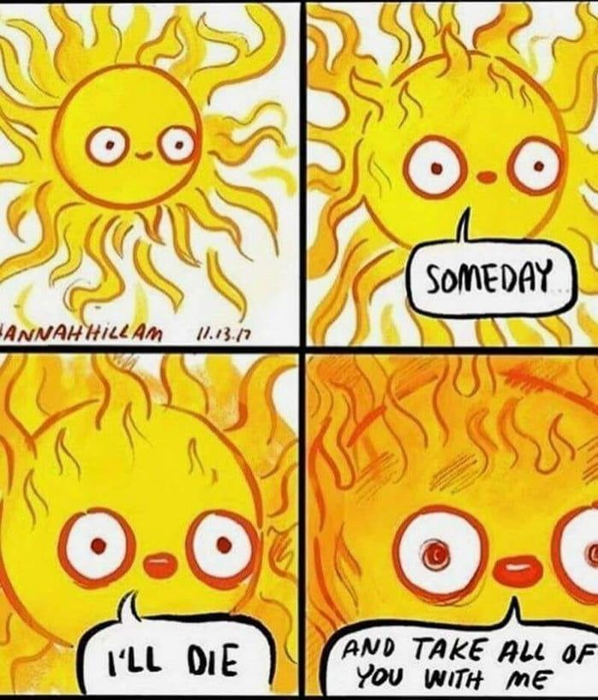
Conclusions
Terminology
New age → Remote and in-situ more connected than ever before.
Most of people agreed on not using ICME, but CME.
Flux tube - Flux rope, Magnetic obstacle - Ejecta, Magnetic cloud.
We need some consistency in the terminology to integrate the remote sensing and in situ studies.
Perspective - Remote sensing and also in-situ
We need more points of observation - preferably fixed
Models - Still room for improvement
Composition as the key for CME origin?

