Slide 1

SHINE, June 28th, 2022
Multiscale Nature of Turbulence in Space Plasmas
Particle Laden Turbulence
Yan Yang 杨艳
University of Delaware
Bill Matthaeus, Riddhi Bandyopadhyay, Tulasi Parashar, Rohit Chhiber, Vadim Roytershteyn, Alexandros Chasapis, Oreste Pezzi, Francesco Pecora, Yanwen Wang, Sohom Roy, Minping Wan, and collaborators…
yanyang@udel.edu

Slide 2
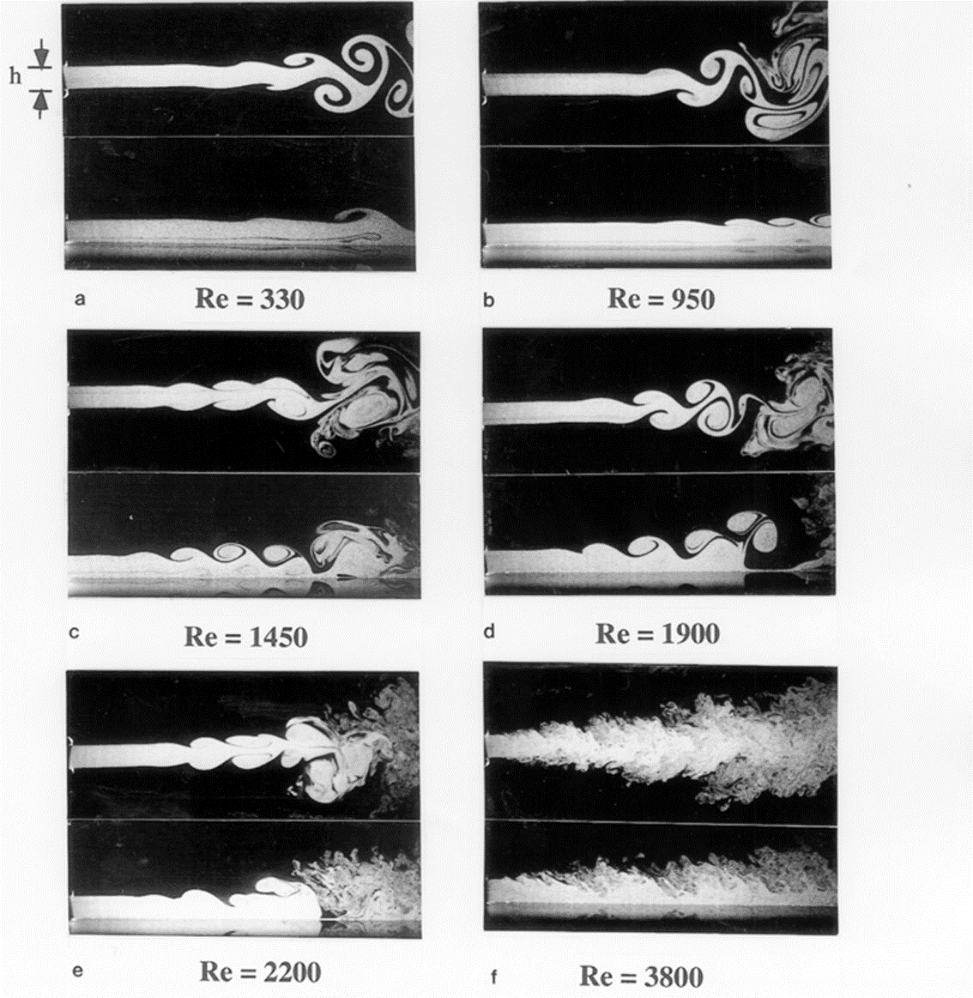
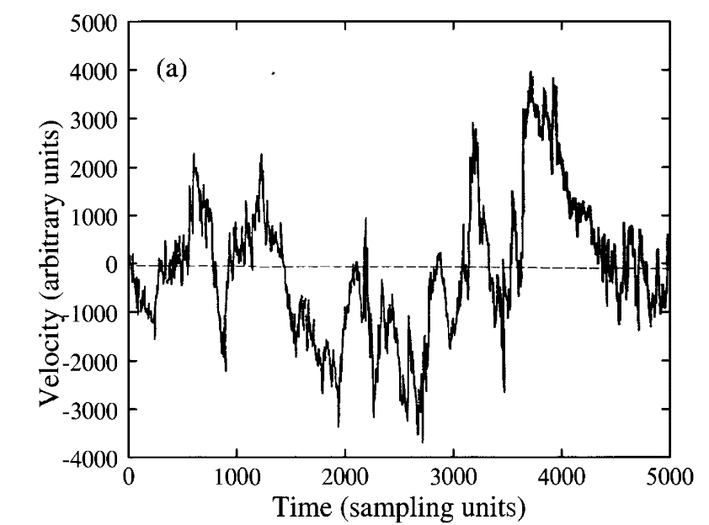
Turbulence: Chaotic Pattern
highly disordered
unpredictable
Uriel Frisch, Turbulence
Samimy et al, A Gallery of Fluid Motion
yanyang@udel.edu
2

Slide 3
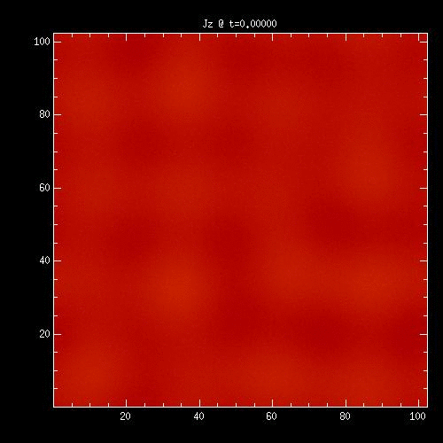
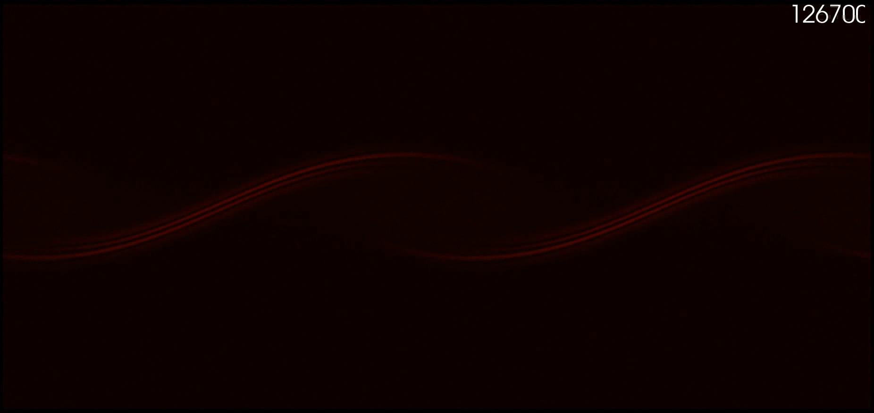
Turbulence: Hierarchy
(Wu et al, PRL, 2012)
(Karimabadi et al, PoP, 2013)
Hierarchy of coherent structures
yanyang@udel.edu
3

Slide 4
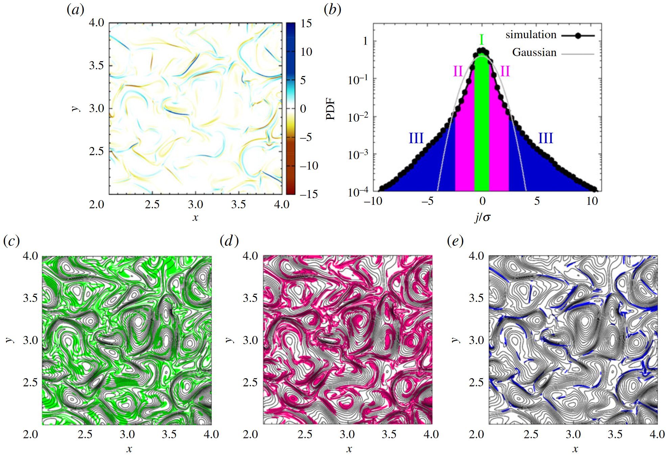
Turbulence: Intermittency
Matthaeus et al, Phil. Trans. R. Soc. A., 2015
yanyang@udel.edu
4

Slide 5
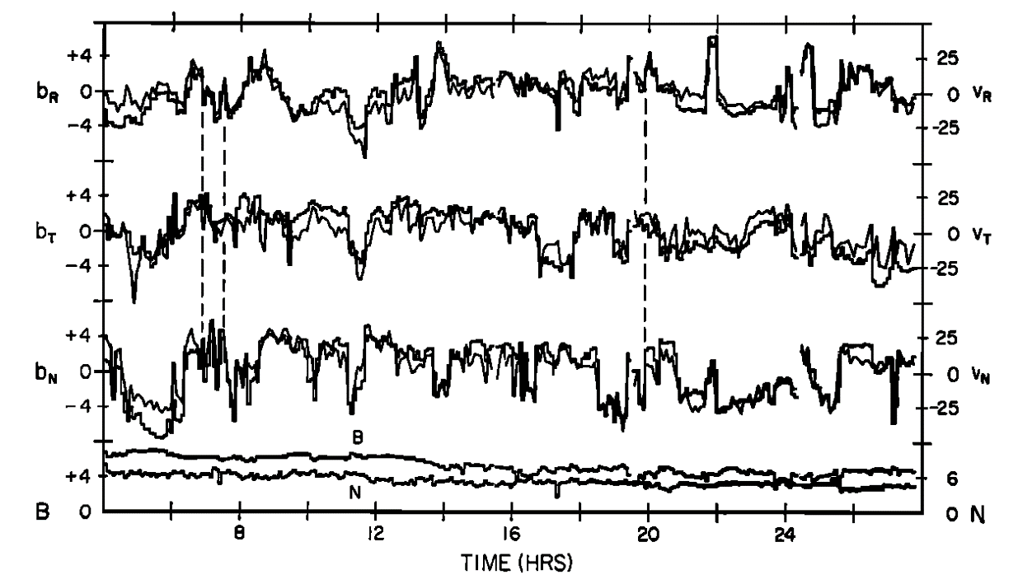
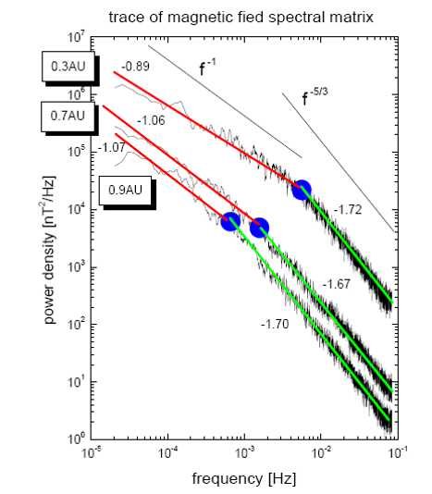
Plasma Turbulence: Solar Wind
Mariner 2 data, Belcher et al, JGR, 1971
Indication of turbulence and wave-like properties
Broadband spectrum
Bavassano et al, JGR, 1982
yanyang@udel.edu
5

Slide 6
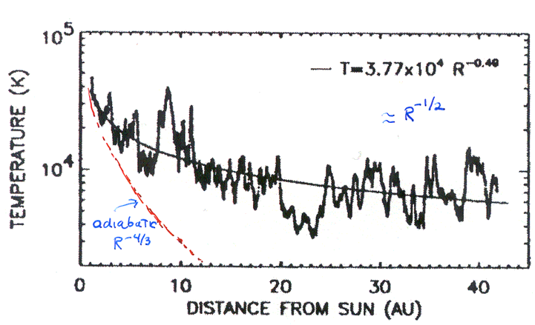
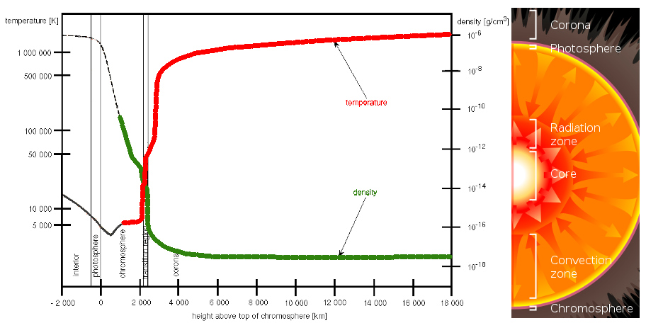
Solar Wind Heating
Can turbulence help to explain this?
Voyager proton temperature, Richardson et al, GRL, 1995
yanyang@udel.edu
6

Slide 7
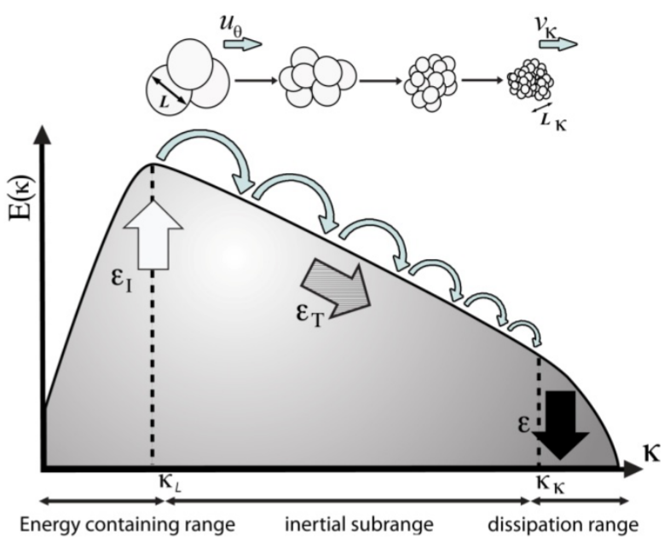
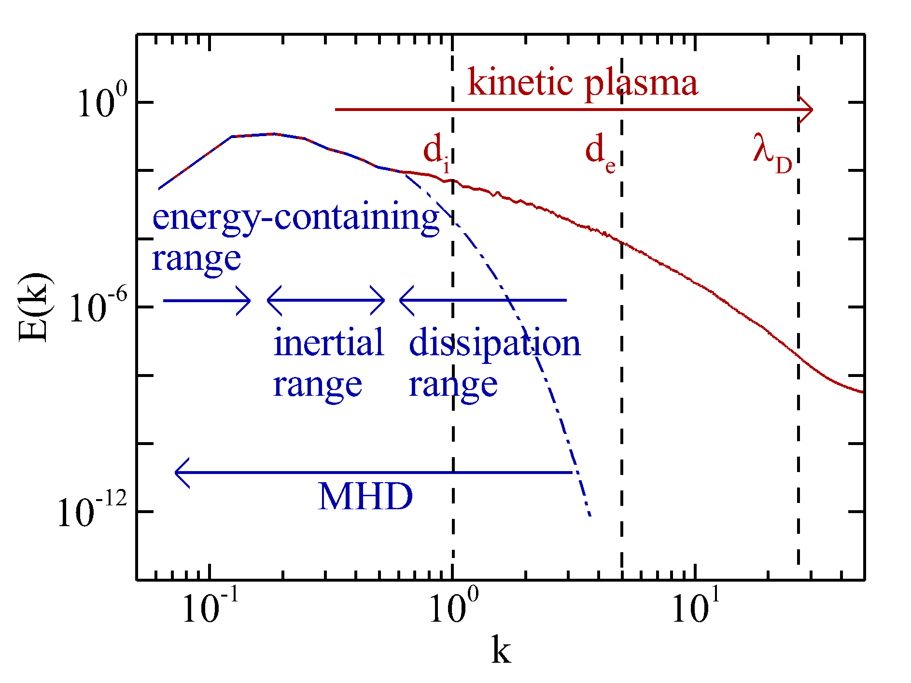
Heating by Turbulent Cascade
Energy Containing Scale
?
MHD Inertial range
?
Kinetic Scale
?
Energy dissipation
Sagaut et al, 2006
Yang, Springer, 2019
yanyang@udel.edu
7

Slide 8
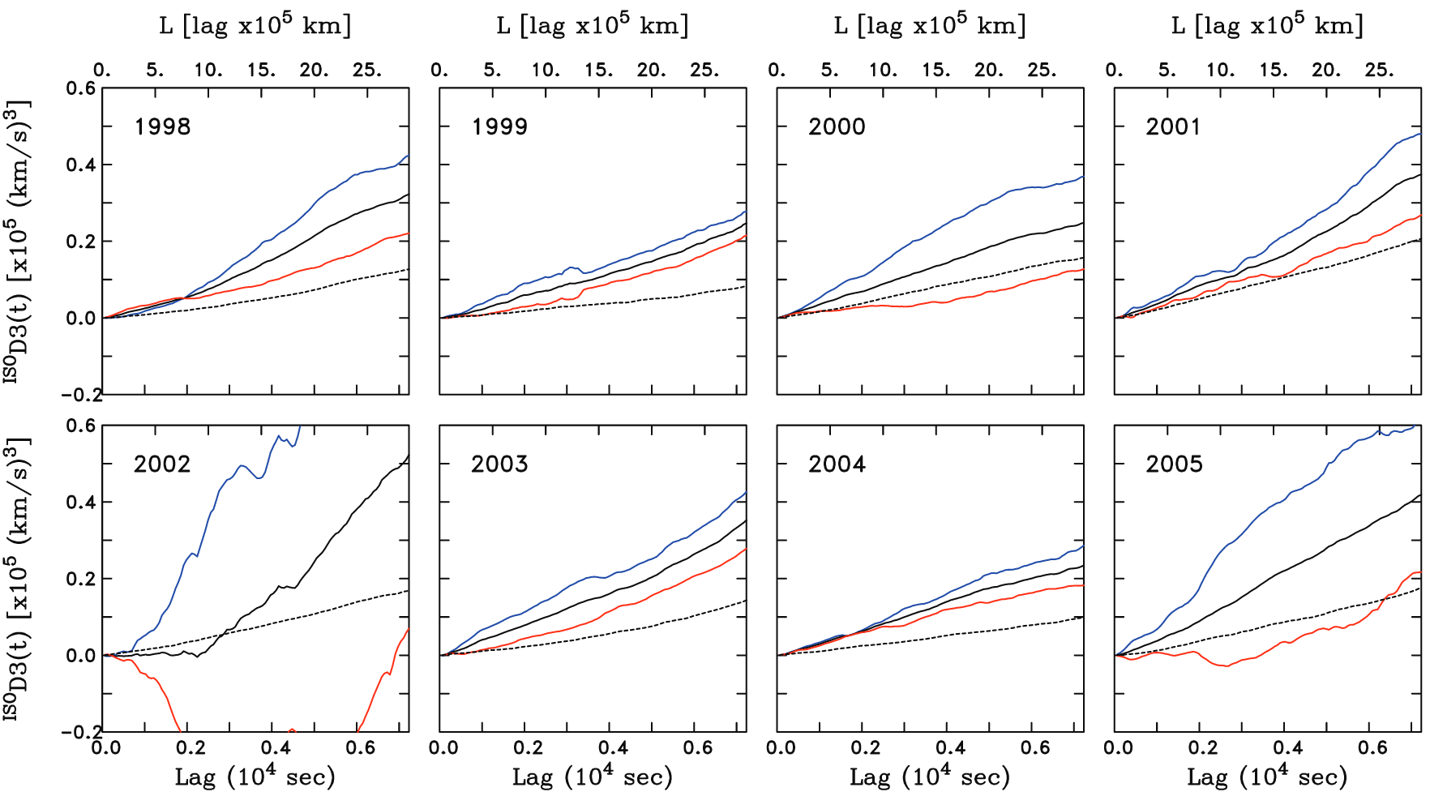
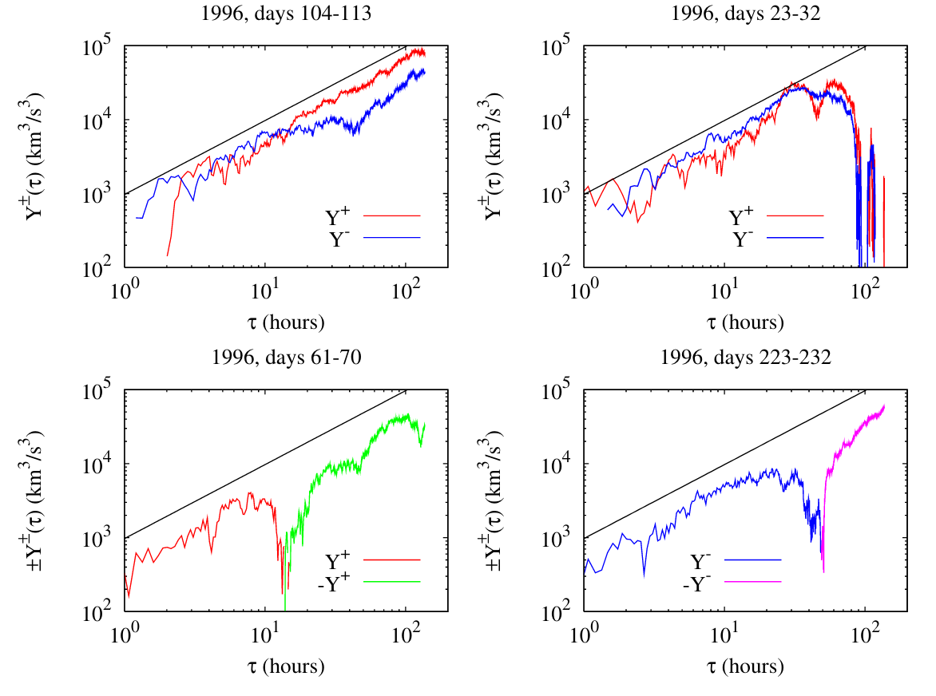
Energy Transfer Rate– 3rd Order Law
(1D form) Third-order Law
Politano & Pouquet, GRL, 1998
Isotropy + homogeneity + inertial range
A fixed lag direction
A range of lag magnitudes
ACE, Solar Wind
MacBride et al, ApJ, 2008
Ulysses, Solar Wind
Sorriso-Valvo et al, PRL, 2007
yanyang@udel.edu
8

Slide 9
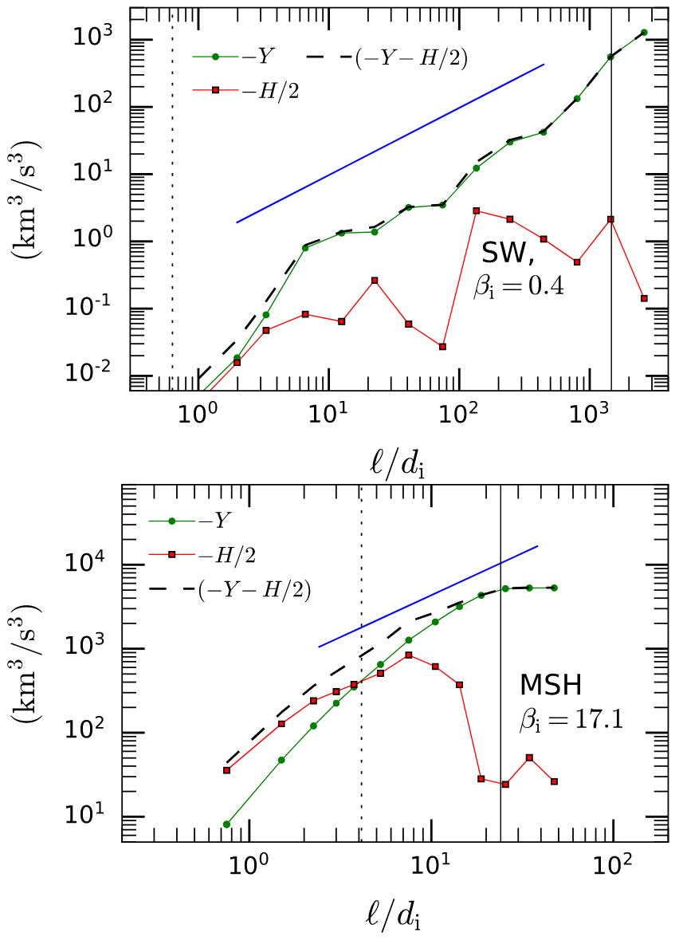
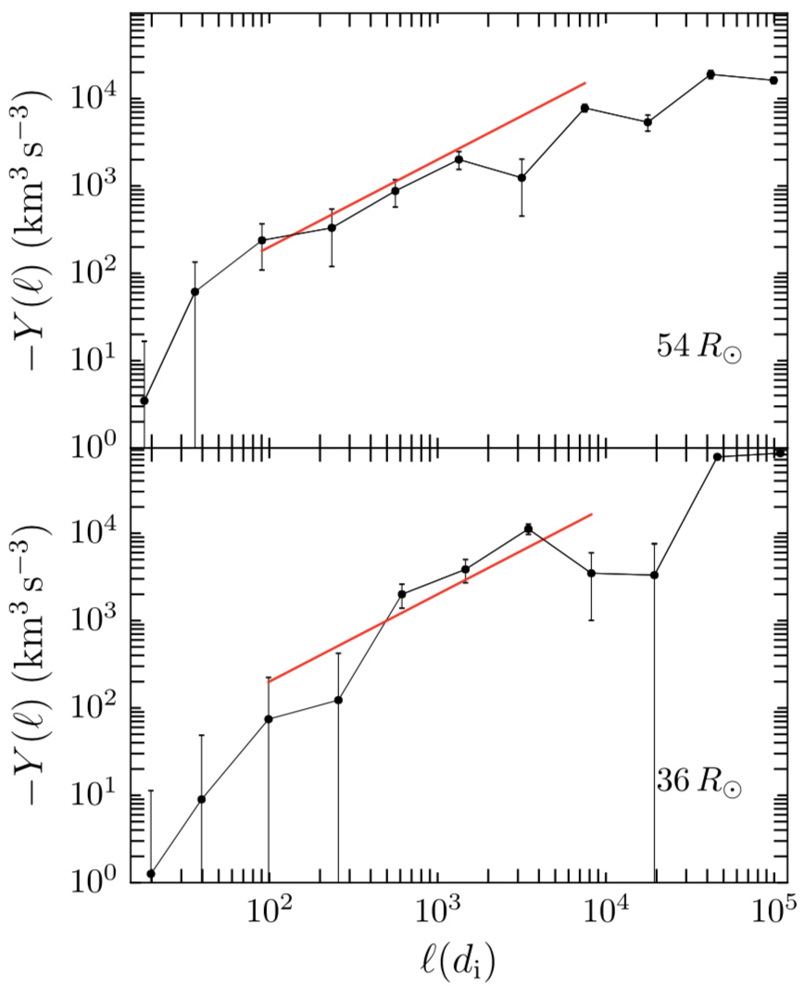
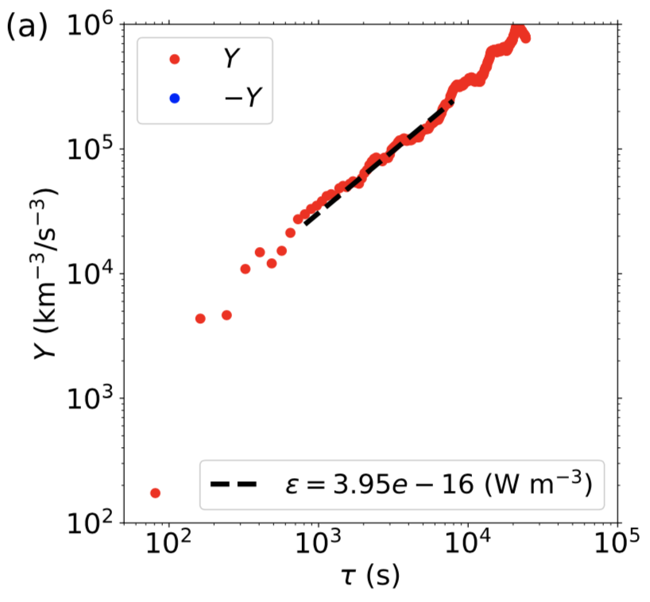
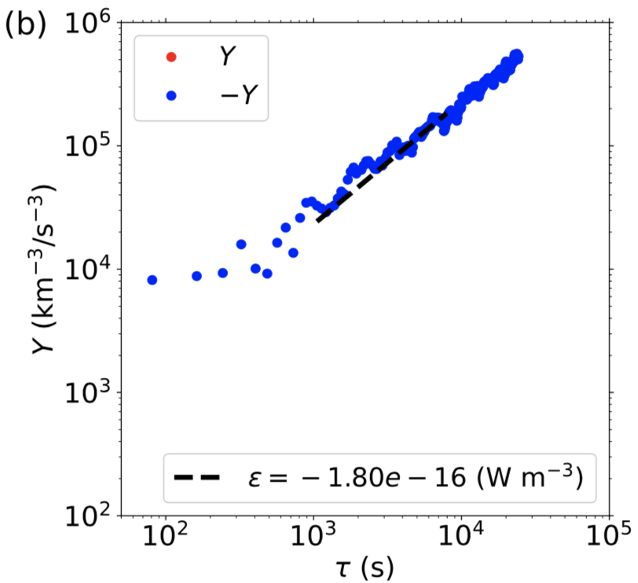
Energy Transfer Rate– 3rd Order Law
MMS
Bandyopadhyay et al, PRL, 2020
PSP, Solar Wind
Bandyopadhyay et al, ApJ, 2020
Helios, Solar Wind
Wu et al, ApJ, 2022
yanyang@udel.edu
9

Slide 10
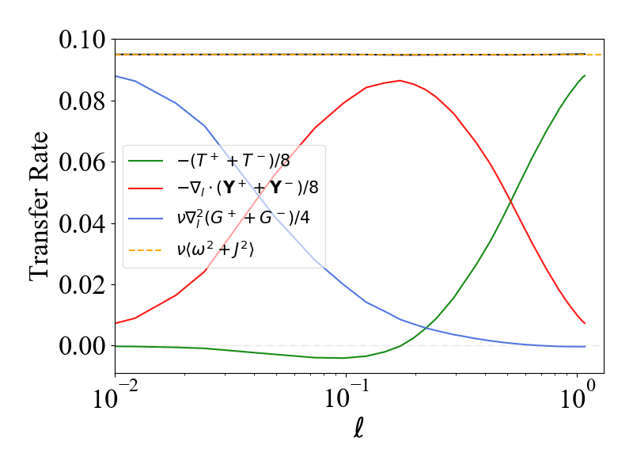
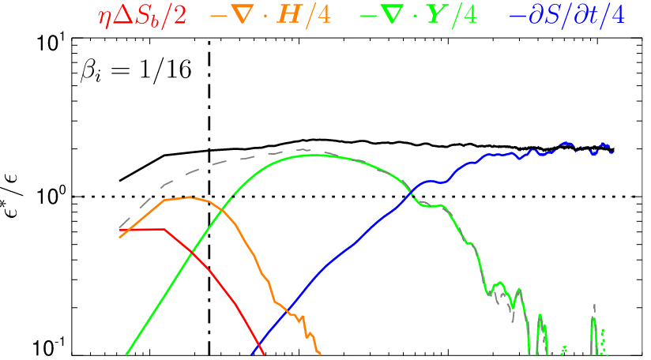
Energy Transfer Rate– Von Karman Howarth Equation
VKH Equation
Homogeneity
It does not require isotropy.
It does not require large Re.
It is a function in 3D lag space .
It is exact at every .
Wang et al, submit to ApJ, 2022
Hellinger et al, ApJ, 2018
yanyang@udel.edu
10

Slide 11
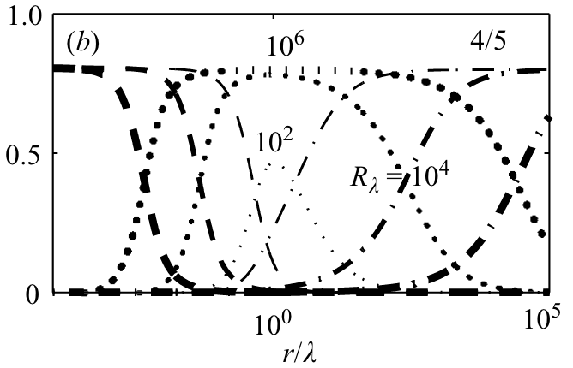
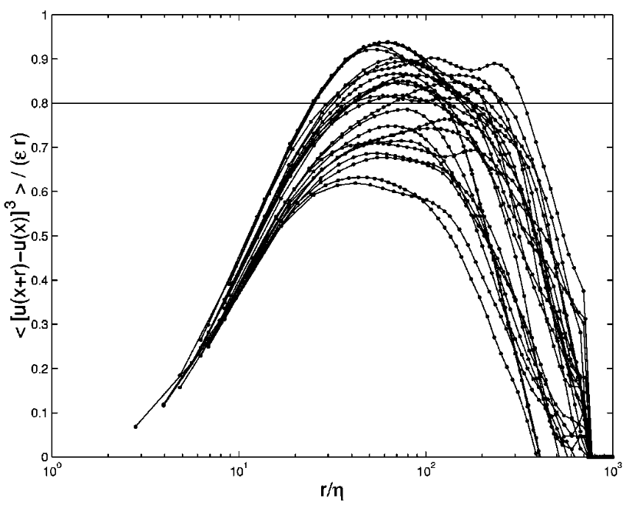
Simplifications of VKH Equation– 3D form and 1D form
Antonia & Burattini, JFM, 2006
3D form of 3rd-order law
Homogeneity + Well-defined Inertial range
It does not require isotropy.
It requires 3D lag-space derivatives.
1D form of 3rd-order law
Isotropy + homogeneity + inertial range
It could depend on the direction of lag.
HD turbulence
Taylor et al, PRE, 2003
yanyang@udel.edu
11

Slide 12
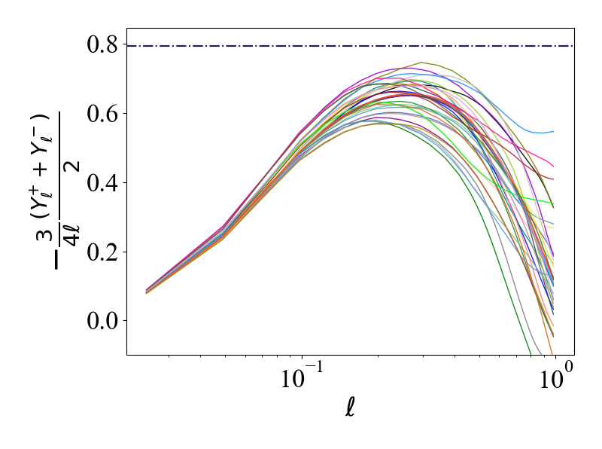
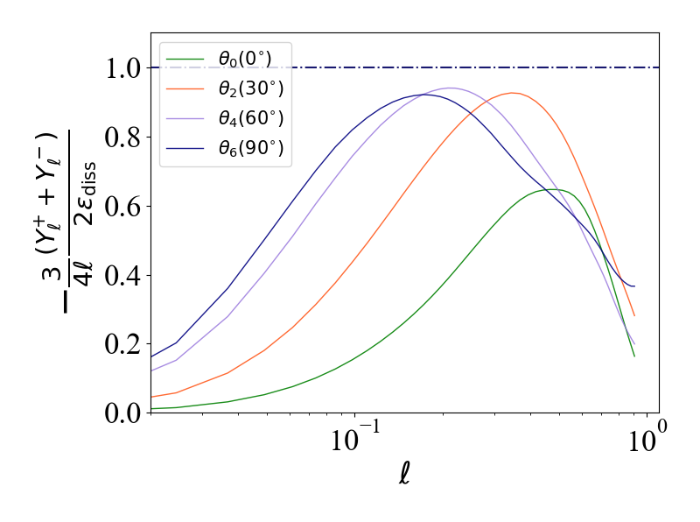
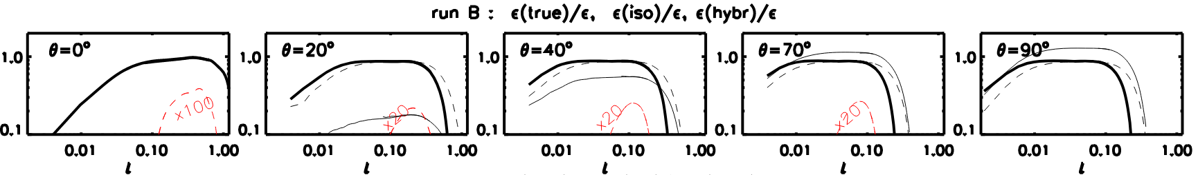






1D Form of 3rd-order Law
$$l_{||}$$
$$θ$$
$$\hat{l}$$
$$l_{⊥}$$
$$φ$$
Isotropic
Anisotropic
$$l_{⊥}$$
Wang et al, submit to ApJ, 2022
Verdini et al, ApJ, 2015
yanyang@udel.edu
12

Slide 13
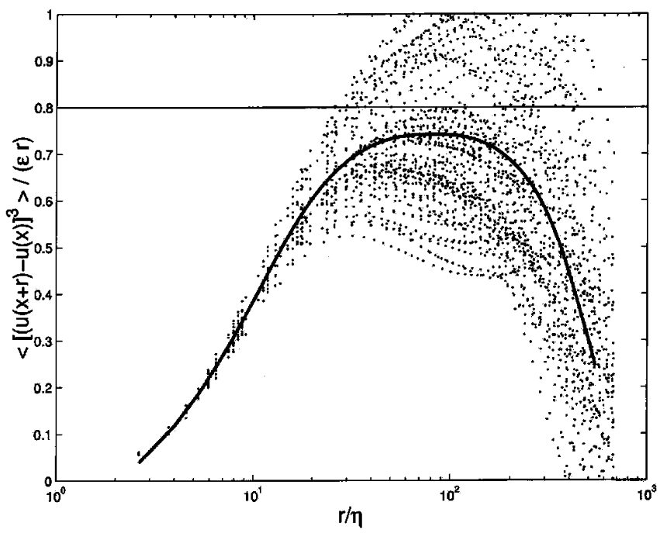
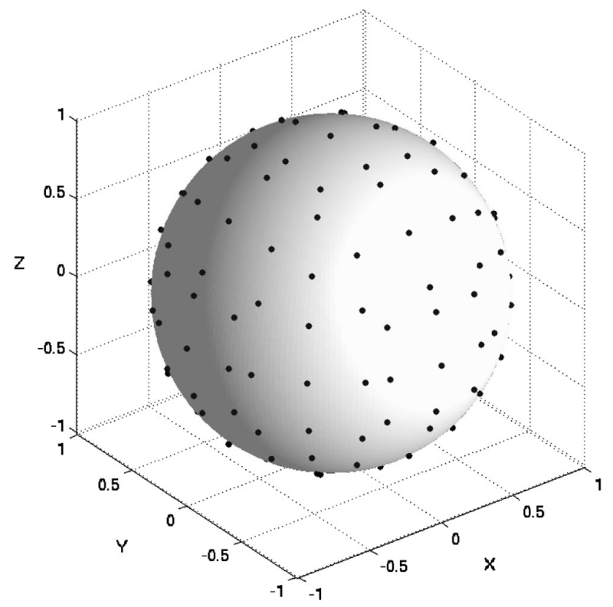
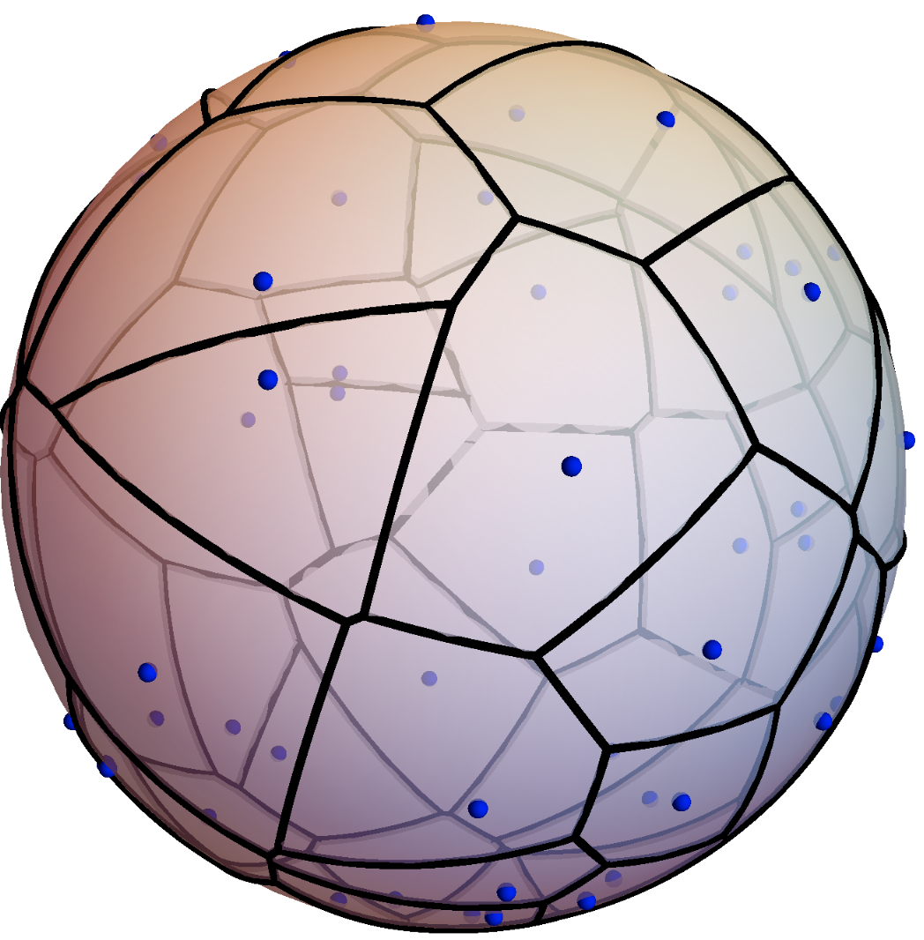
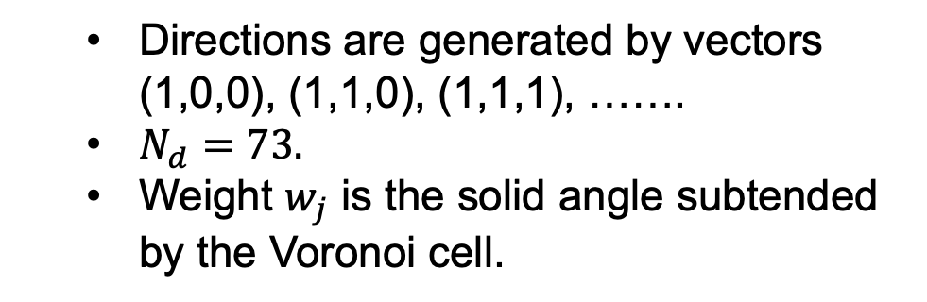
Angle Averaging Technique
Fixed 73 directions
Directions are generated by vectors (1,0,0), (1,1,0), (1,1,1), …….
$N_{d}=73.$
Weight $w_{j}$ is the solid angle subtended by the Voronoi cell.
Nie & Tanveer, 1999
Taylor et al, PRE, 2003
73 directions
Voronoi cell
yanyang@udel.edu
13

Slide 14
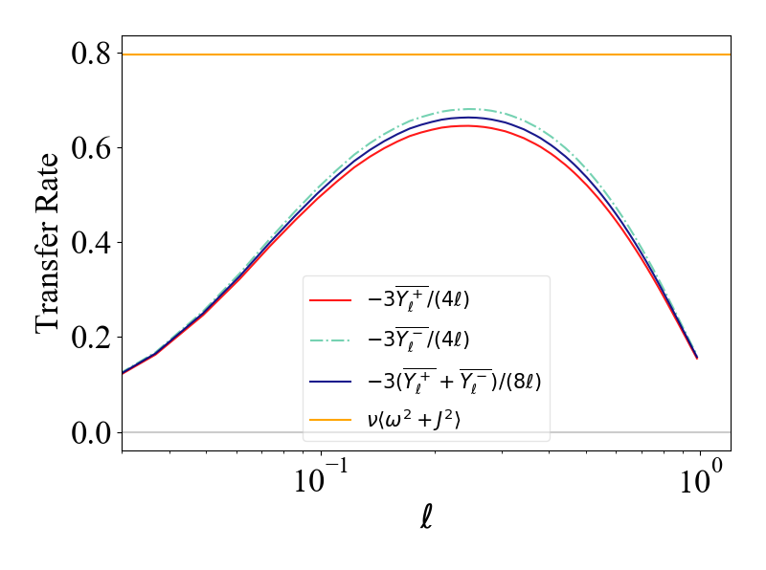
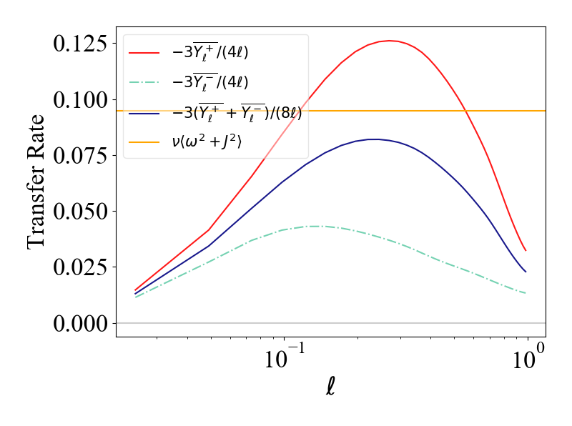
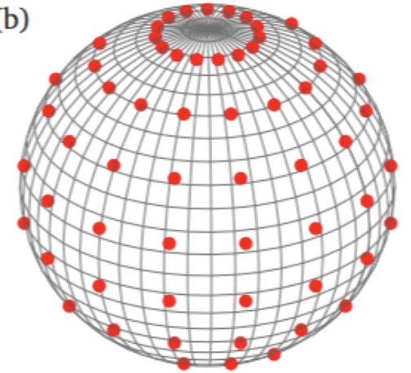
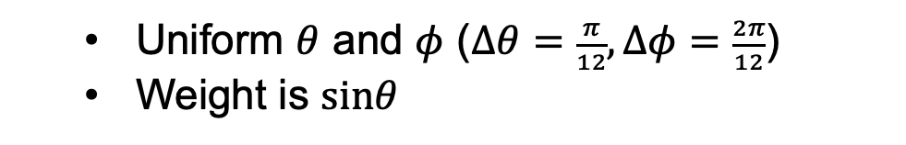
Angle Averaging Technique
Uniform directions
Wang et al, submit to ApJ, 2022
Uniform $θ$ and $φ$ ($Δθ=\frac{π}{12}, Δφ=\frac{2π}{12}$)
Weight is $sinθ$
Isotropic
Anisotropic
yanyang@udel.edu
14

Slide 15
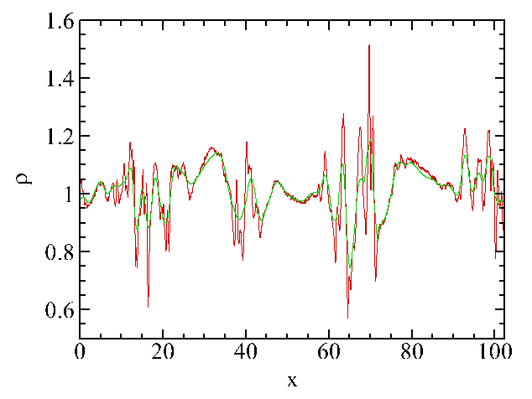
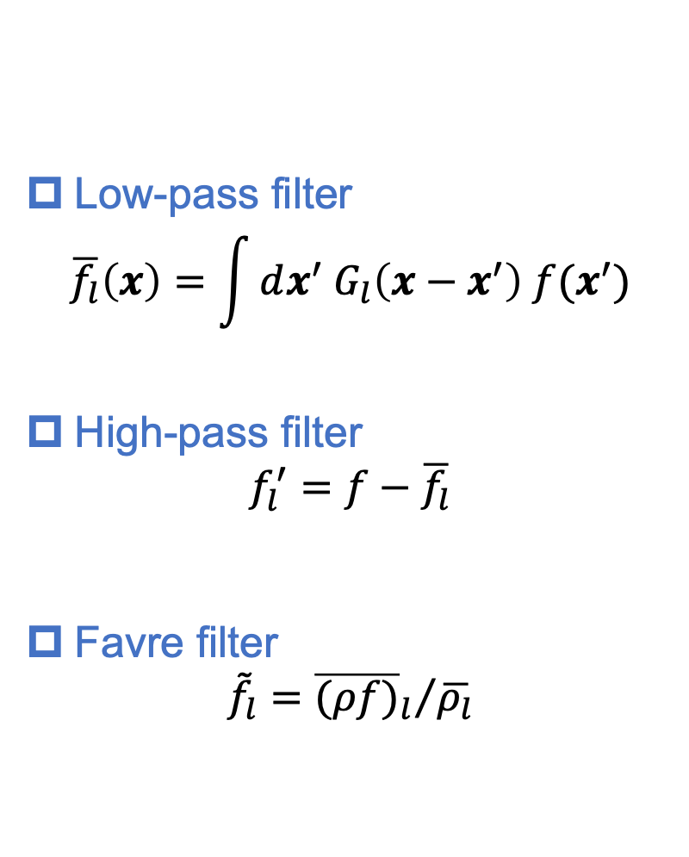
Scale-by-scale Dynamics: Scale Filter
Low-pass filter
$$\overline{f_{l}}\left(x\right)=\int{dx^{′} G_{l}\left(x−x^{′}\right) f(x^{′})}$$
High-pass filter
$$f_{l}^{′}=f−\overline{f_{l}}$$
Favre filter
$${\tilde{f}}_{l}={{\overline{(ρf)}}_{l}}/{\overline{ρ_{l}}}$$
yanyang@udel.edu
15

Slide 16
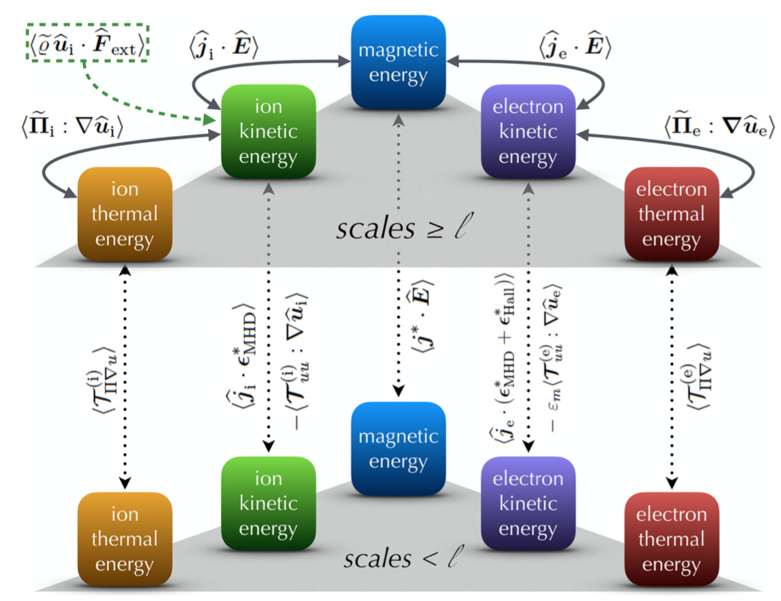
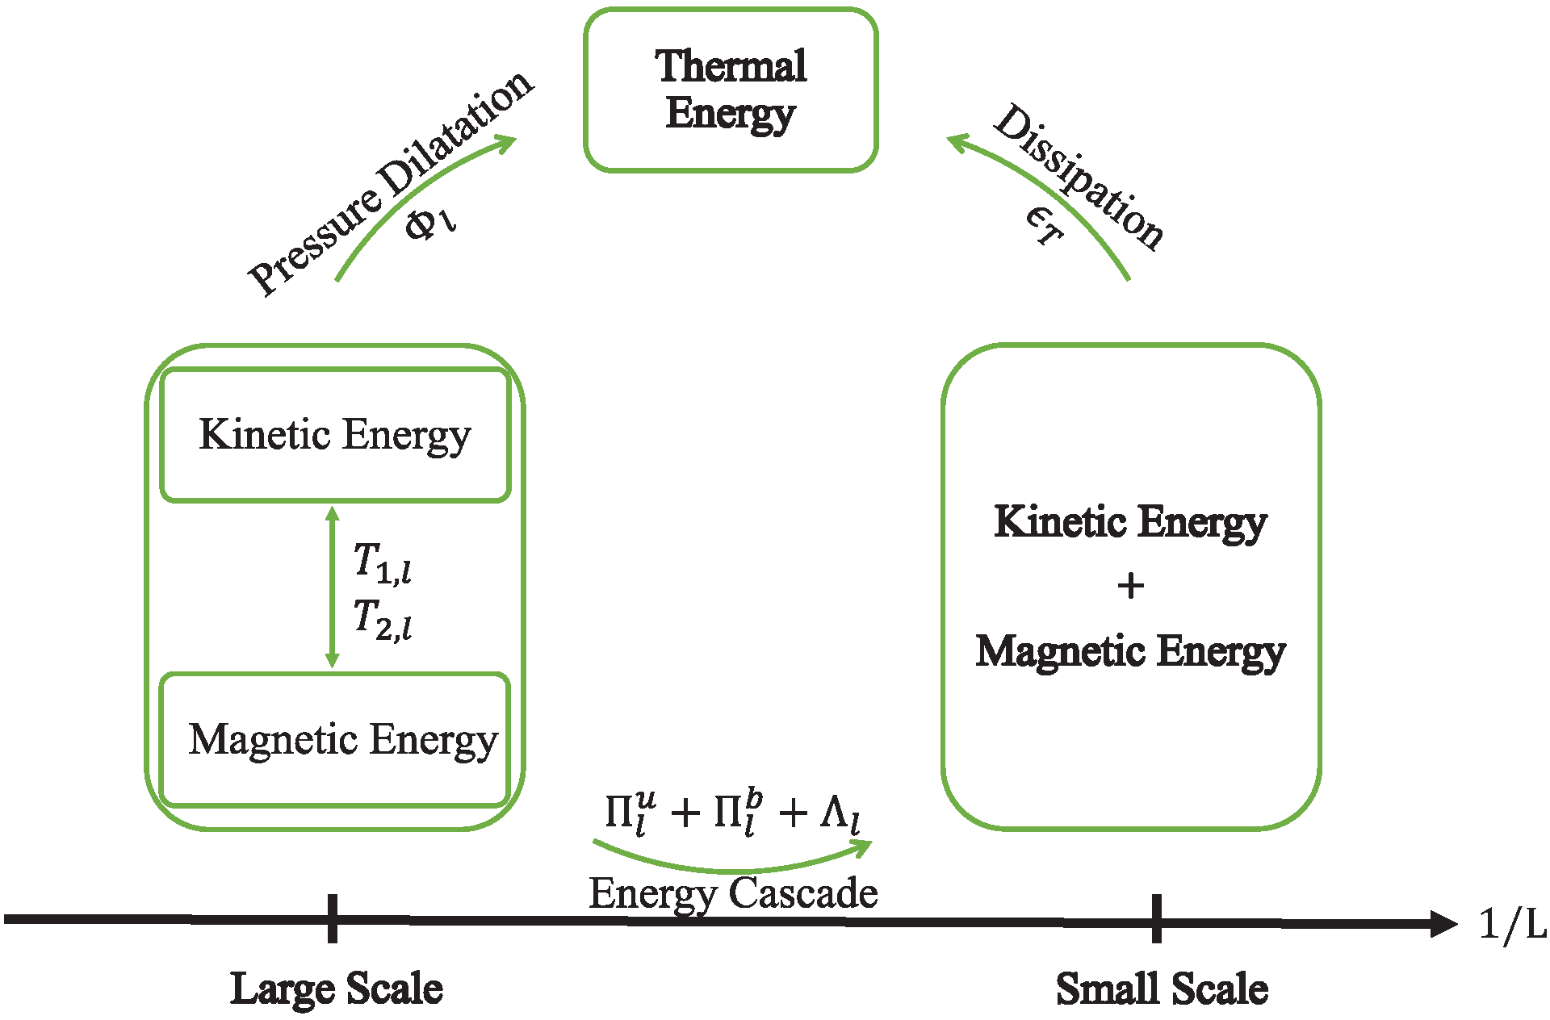
Filtered Energy Equations
MHD model
Kinetic model
Yang et al, PRE, 2016; PoF, 2017
Eyink, PRX, 2019
Cerri & Camporeale, PoP, 2020
yanyang@udel.edu
16

Slide 17
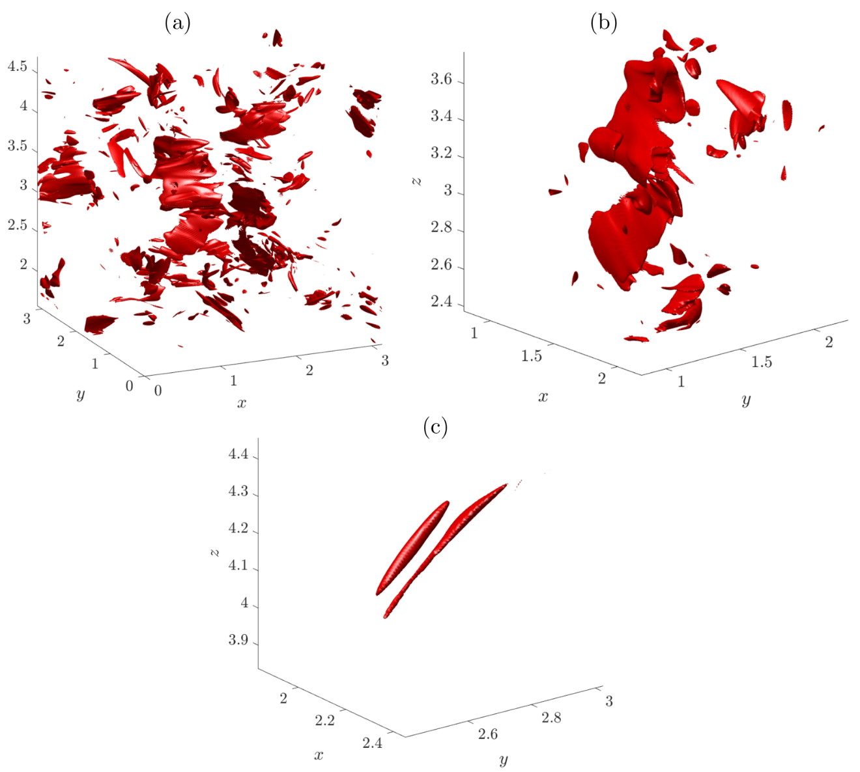
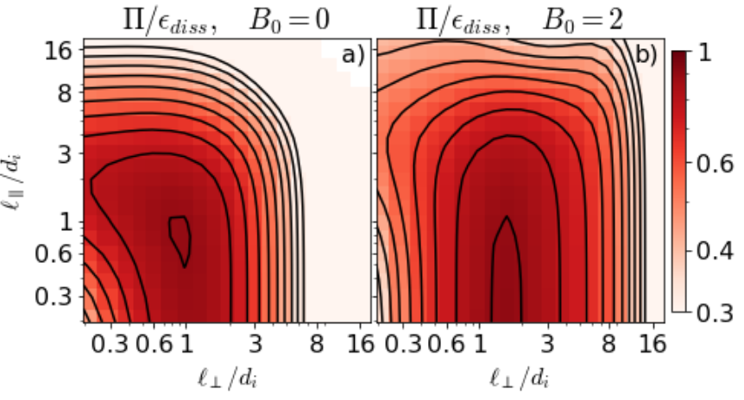
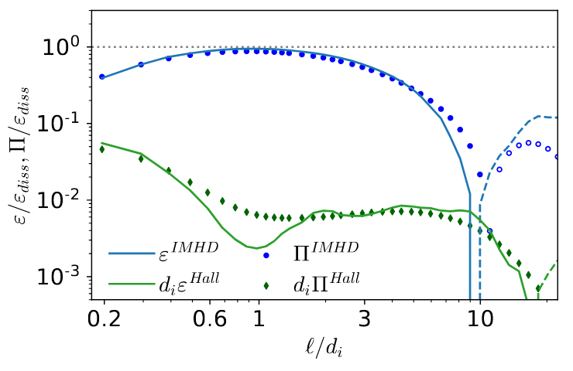
Energy Transfer Flux: $Π$
Manzini et al, arXiv, 2022
Kuzzay et al, PRE, 2019
yanyang@udel.edu
17

Slide 18
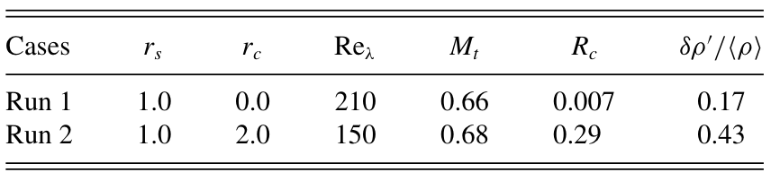
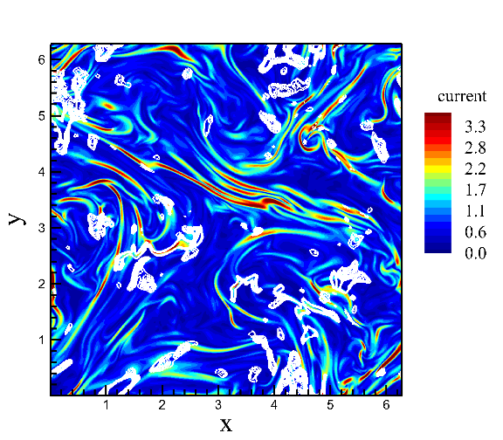
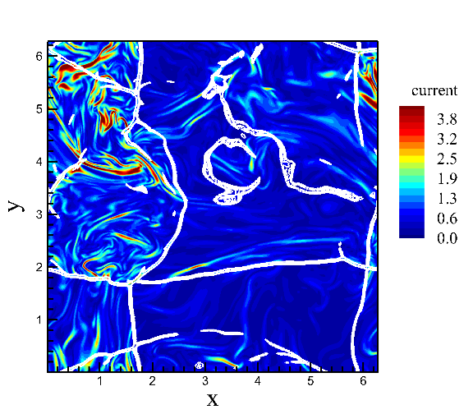
3D Compressible MHD
Yang et al, PRE, 2016
Run1
Run2
yanyang@udel.edu
18

Slide 19
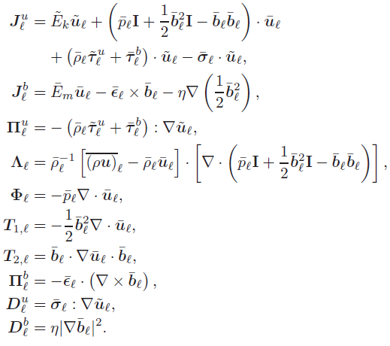
3D Compressible MHD
Terms due to compressibility
yanyang@udel.edu
19

Slide 20
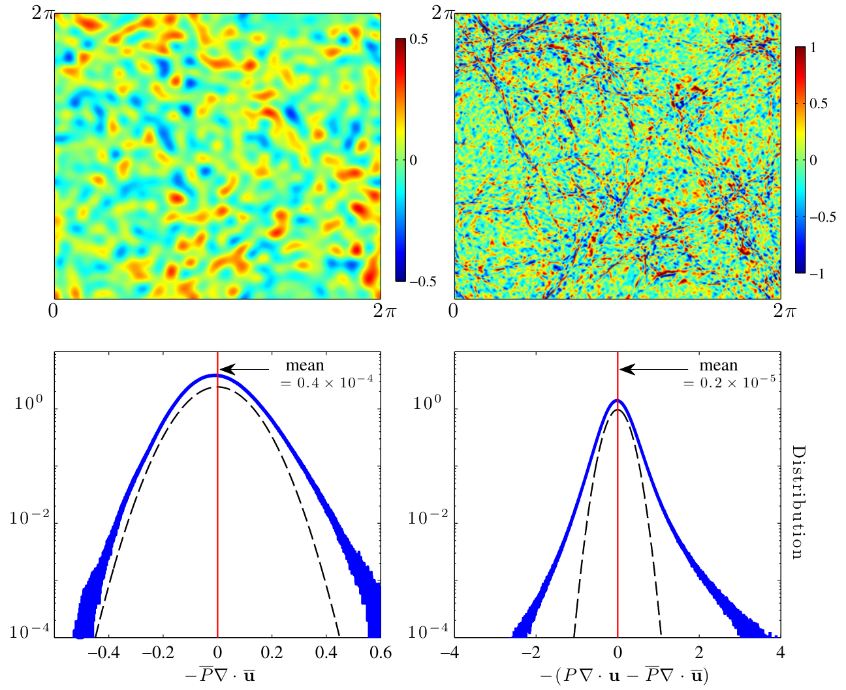
Pressure Dilatation
Alternative pathway to couple kinetic and internal energy.
Two-way exchange between kinetic and internal energy.
Most of its contribution is from large scales.
Aluie et al, ApJ, 2012
yanyang@udel.edu
20

Slide 21
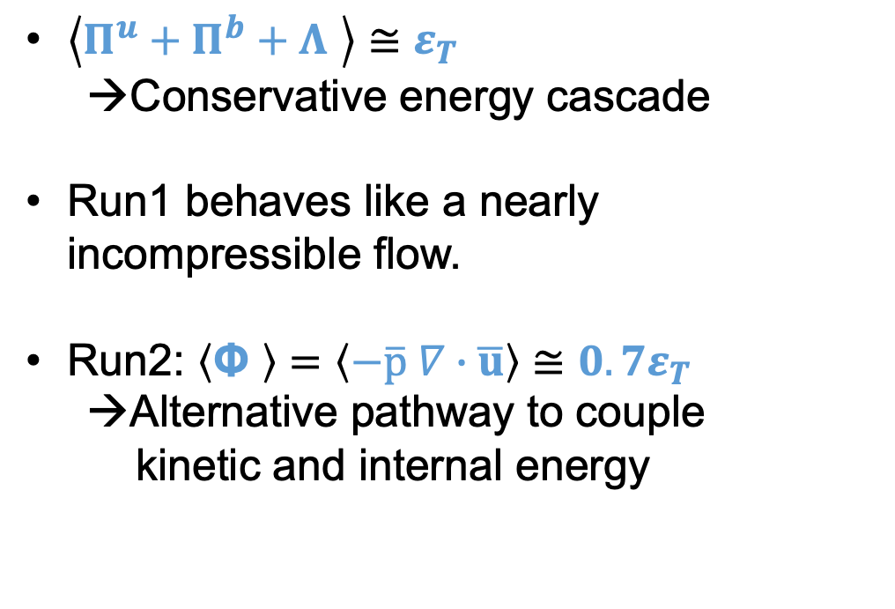
Energy Transfer Flux
$\left\langle Π^{u}+Π^{b}+Λ \right\rangle ≅ε_{T}$
→Conservative energy cascade
Run1 behaves like a nearly incompressible flow.
Run2: $\left\langle \text{Φ} \right\rangle =\left\langle −\overline{p} ∇∙\overline{u}\right\rangle ≅{0.7ε}_{T}$
→Alternative pathway to couple
kinetic and internal energy
yanyang@udel.edu
21

Slide 22
Compressibility Effect
Energy transfer is highly efficient in strongly compressed regions.
yanyang@udel.edu
22

Slide 23
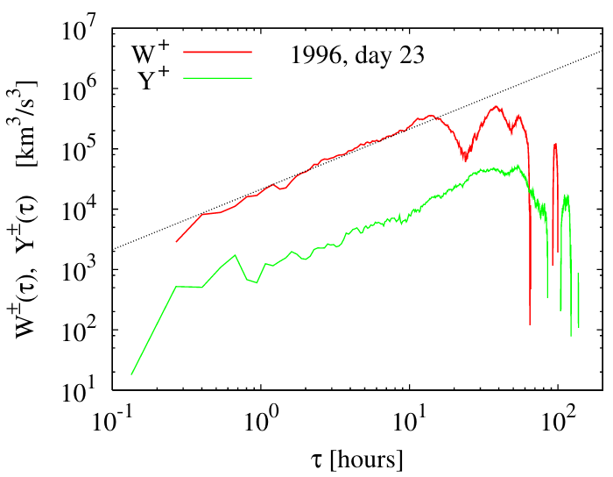
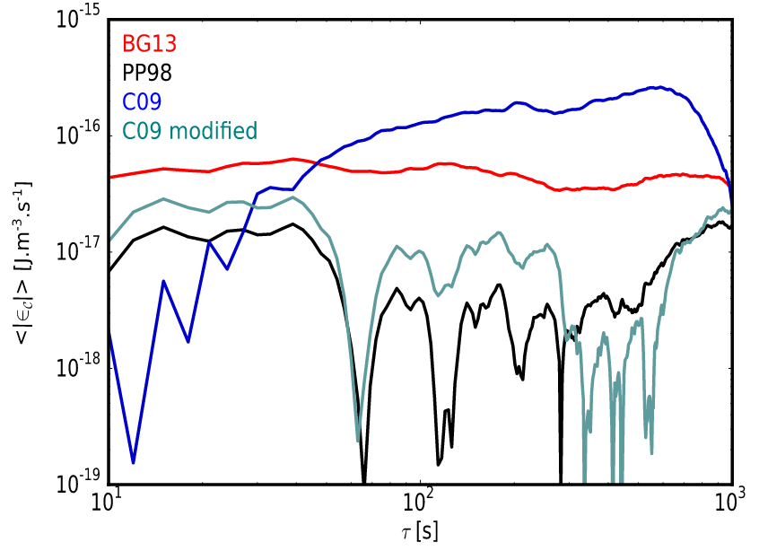
Compressibility Effect
Density weight
Compressible model
Ulysses, Solar Wind
Carbone et al, PRL, 2009
THEMIS, Solar Wind
Banerjee et al, ApJ, 2016
Hadid et al, ApJ, 2017
yanyang@udel.edu
23

Slide 24
Summary
The utility of 3rd order law can give more accurate estimation of transfer rate when the directional average is implemented.
To disentangle the intricate multiscale properties, the multichannel transfer fluxes by applying filtering techniques are helpful.
Compressibility has important effect on the energy transfer process.
yanyang@udel.edu
24

