Slide 1
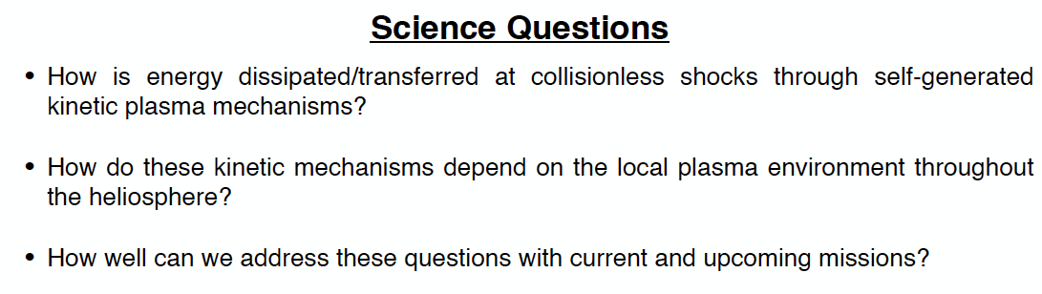
Session #18: The kinetic physics of collisionless shock waves in the heliosphere
Organizers: Jason Tenbarge (Princeton U), Colby Haggerty (Univ. of Hawaii), Alexandros Chasapis (LASP - CU Boulder)
List science questions

Slide 2
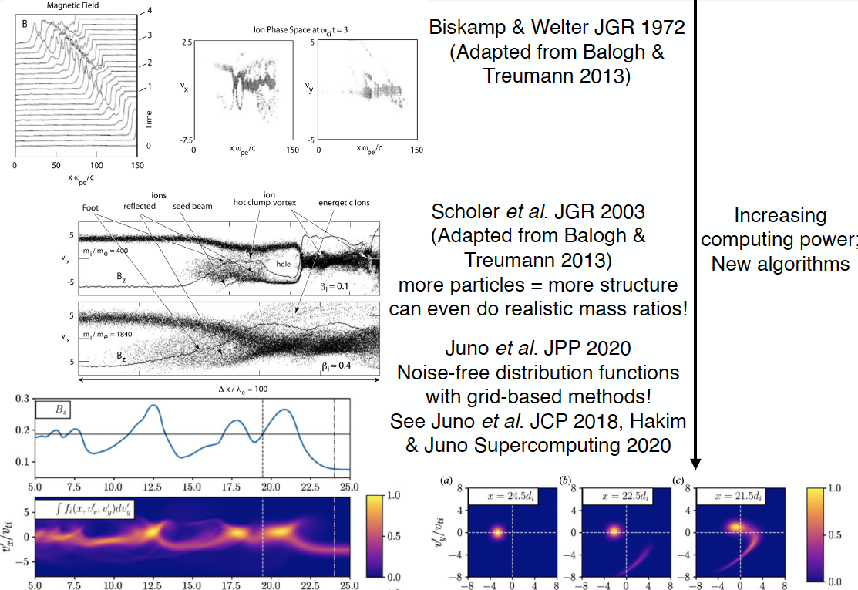
Session #18: Collisionless shocks
Theory
Jimmy Juno, PPPL
Examine energy transfer with numerical simulations
Claim: The answer to dissipation is found in phase space
Phase space evolution is complicated to describe numerically, continuous effort through the years
2020: Direct numerical discretization of Vlasov-Maxwell equations

Slide 3
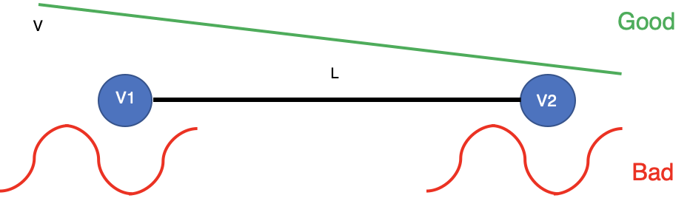
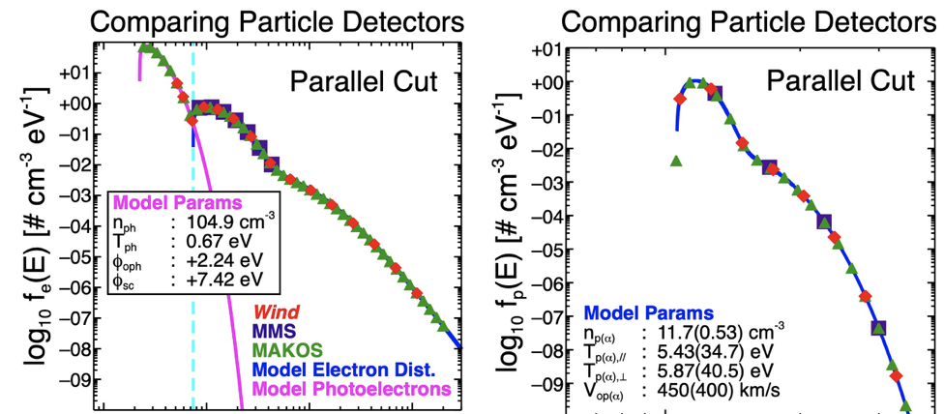
Session #18: Collisionless shocks
Observations
Katy Goodrich, West Virginia University
Claim: Accurate measurement of large-amplitude, electromagnetic waves is key to understanding dissipation in shocks
Plasma measurements optimized for bow-shock populations are necessary
MMS fairly limited in capability beyond magnetosheath

Slide 4

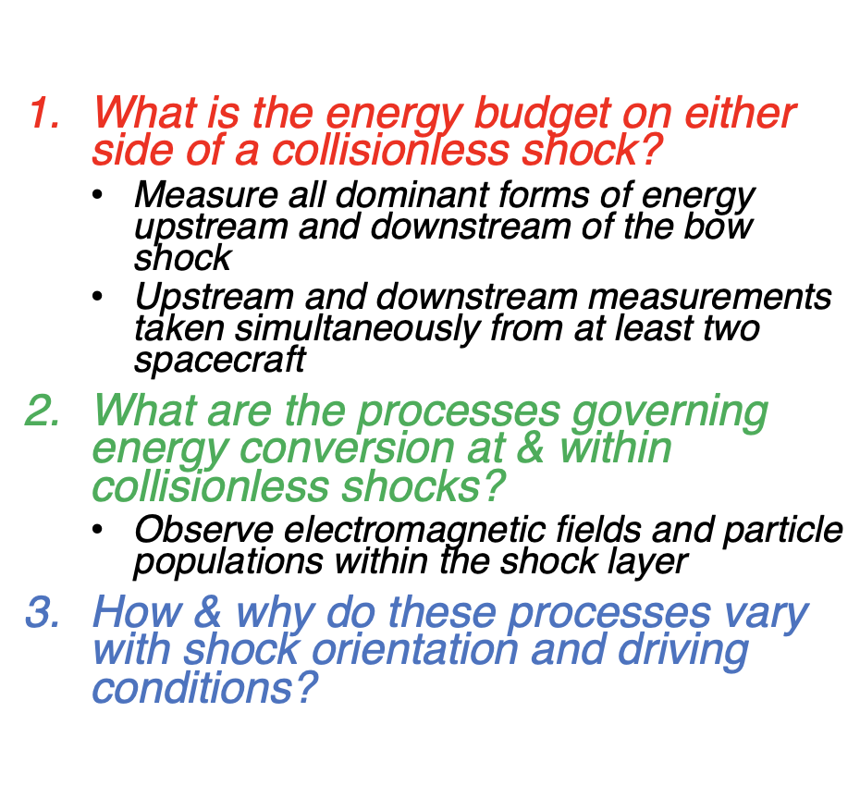
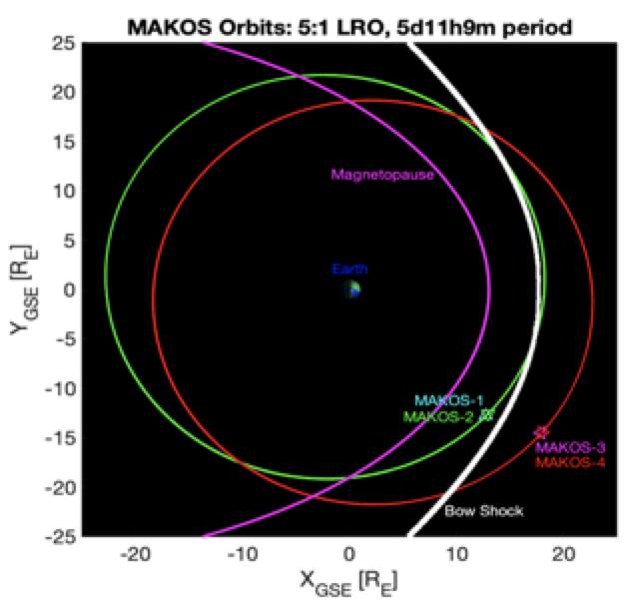
Session #18: Collisionless shocks
Observations
MAKOS: a space mission dedicated to shock physics

Slide 5
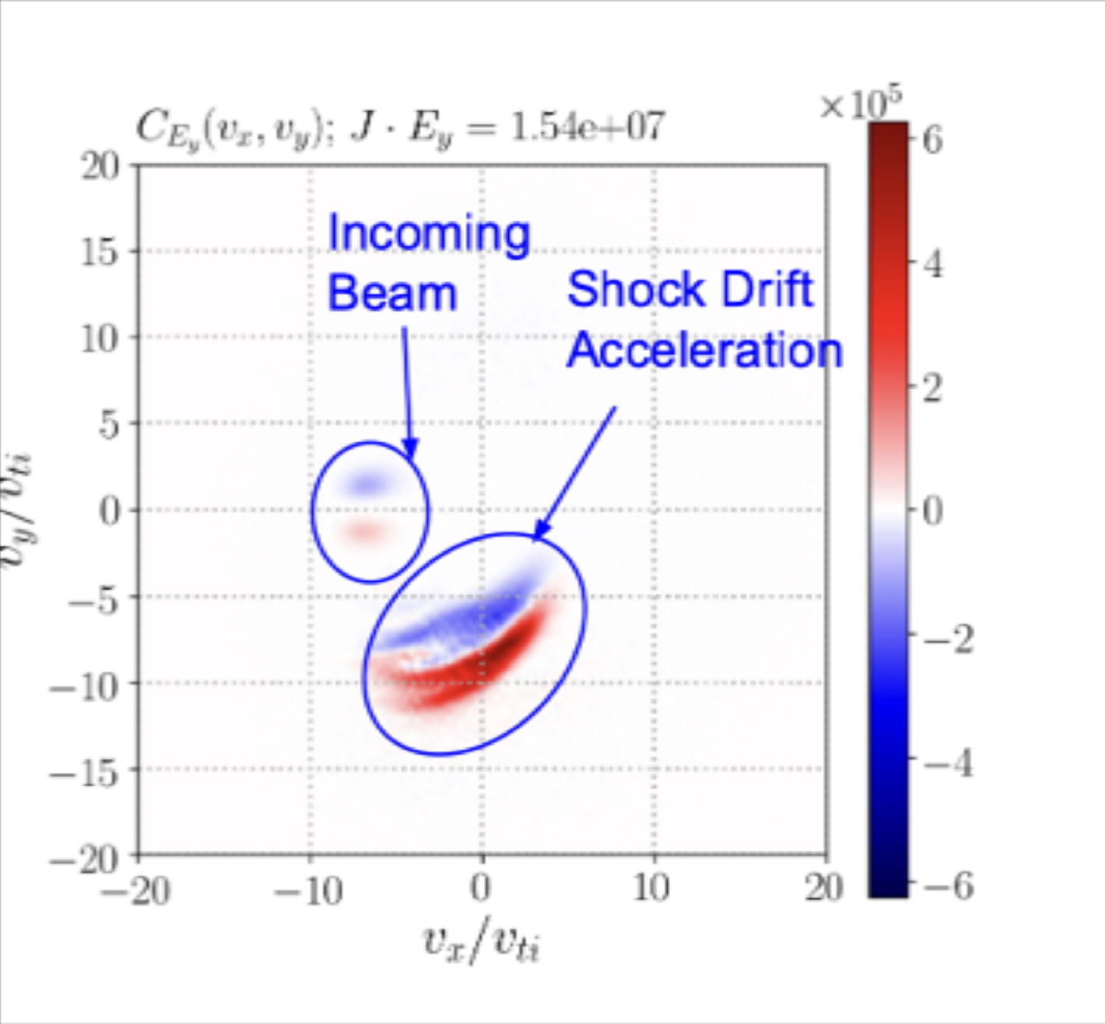
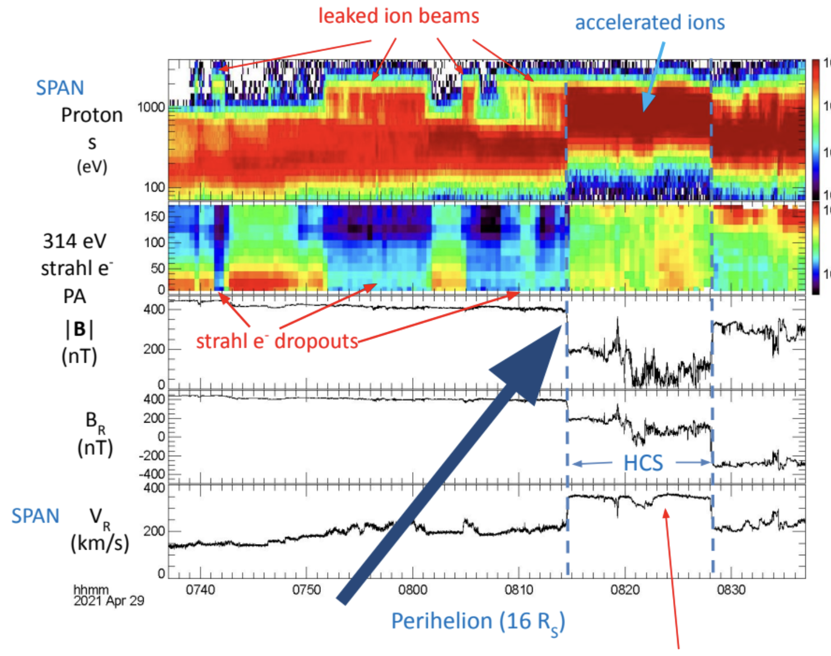
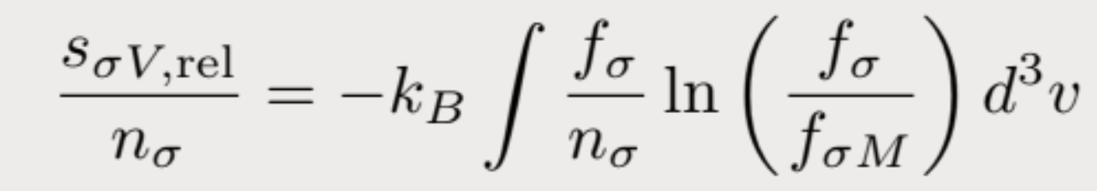
Session #18: Collisionless shocks
Discussion
Different novel dissipation measurements were discussed to identify phase space energization, including field particle correlations, and kinetic entropy (HORNET)
Links with laboratory plasma experiments
Importance of accurate description of VDF
Extend observations to other heliospheric environments such as the near-sun HCS
Novel kinetic entropy diagnostic and measurement proposed from Cassak and Barbhuiya
Simulations of field particle correlations of shock ripple in hybrid simulations

