Slide 1
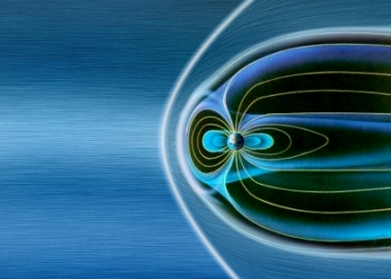





Enhance!
Challenges in Observing Microphysics in Collisionless Shocks
…And How We Shall Rise to Meet Them

Slide 2
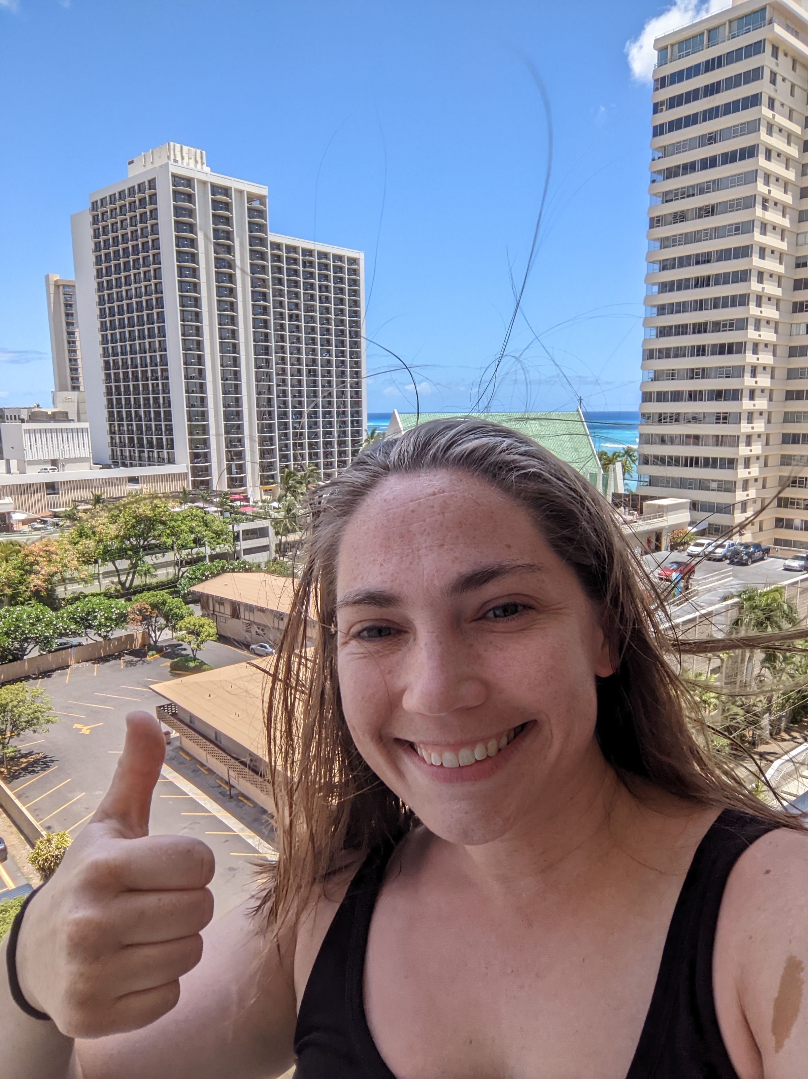
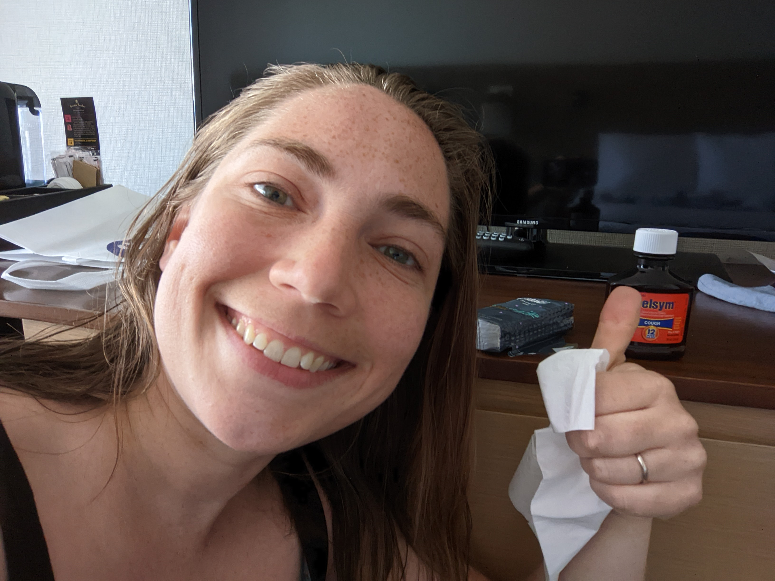
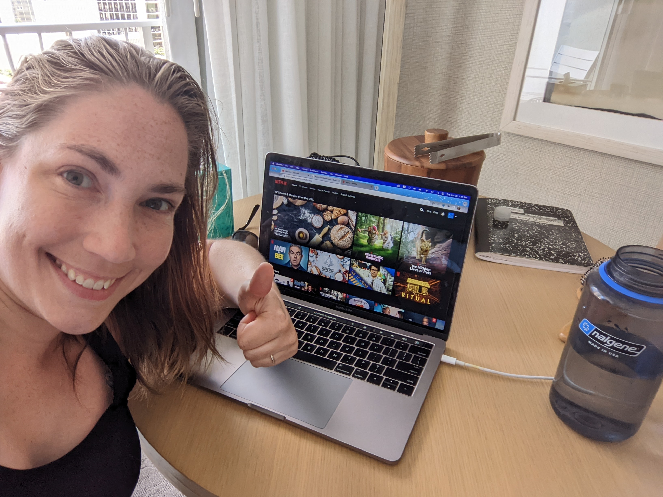
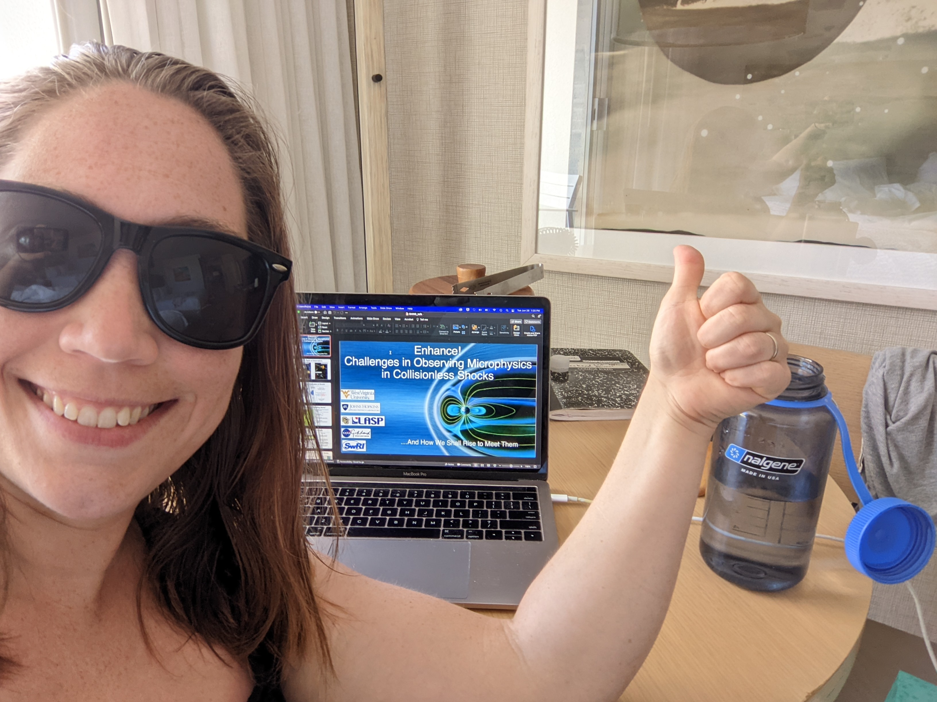
Everything is Fine!
I’m not dead yet! I feel happy!
And everyone else I know feels fine too
Postmates is a good app
I am flush with tissues and cough syrup
(but I don’t need them)
Do not panic!
Go to the beach!
(after my talk, and wear a mask)

Slide 3
SHINE Questions
1) How is energy dissipated/transferred at collisionless shocks through self-generated kinetic plasma mechanisms?
2) How do these kinetic mechanisms depend on the local plasma environment throughout the heliosphere?
3) How well can we address these questions with current and upcoming missions?

Slide 4
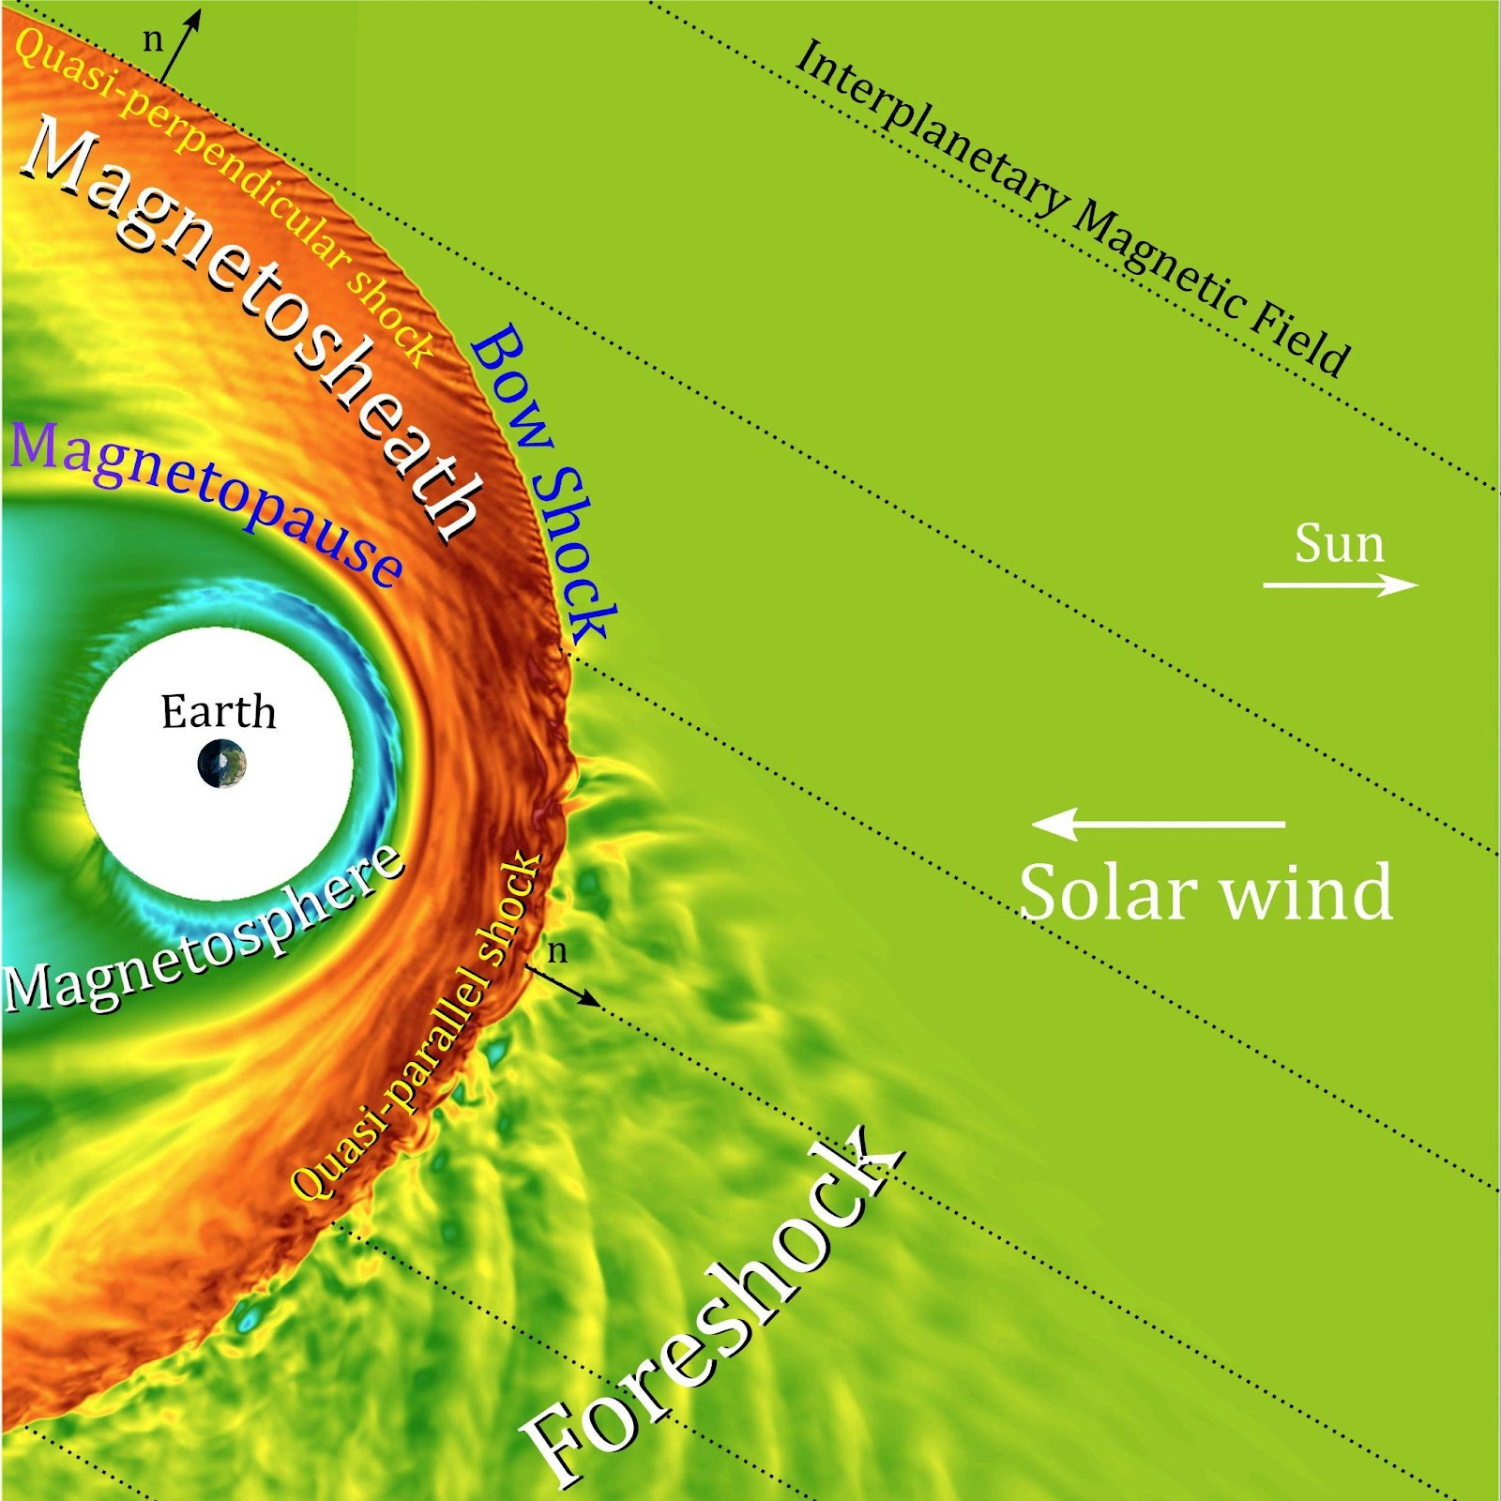

The Shock is a “Breathing Barrier”
Macrostructure of the bow shock is complex due to changes in solar wind
  Speed
  Interplanetary Magnetic Field (IMF) direction
Quasi-perpendicular (n ⟂ IMF)
  Easier to observe
  Shock spatially confined
Quasi-parallel (n || IMF)
  Easier for particles to escape upstream
  Shock elongated into turbulent upstream
Ram -> Not Ram Energy?
  Depends on what kind of shock you are
  And what the sun is doing at any given moment

Slide 5
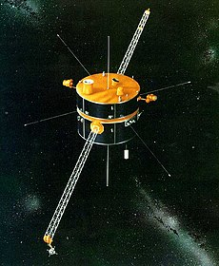
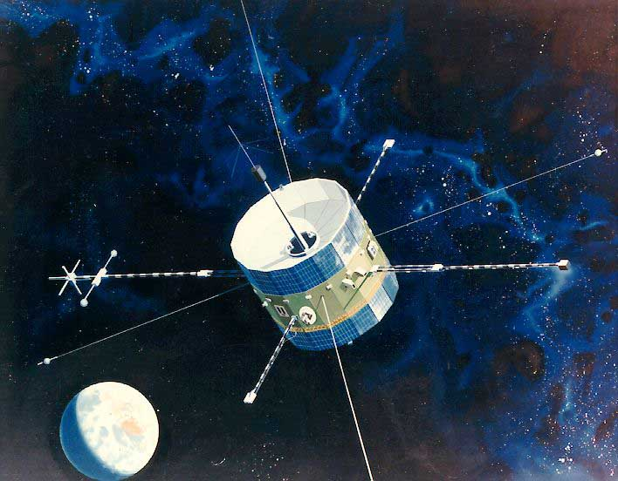
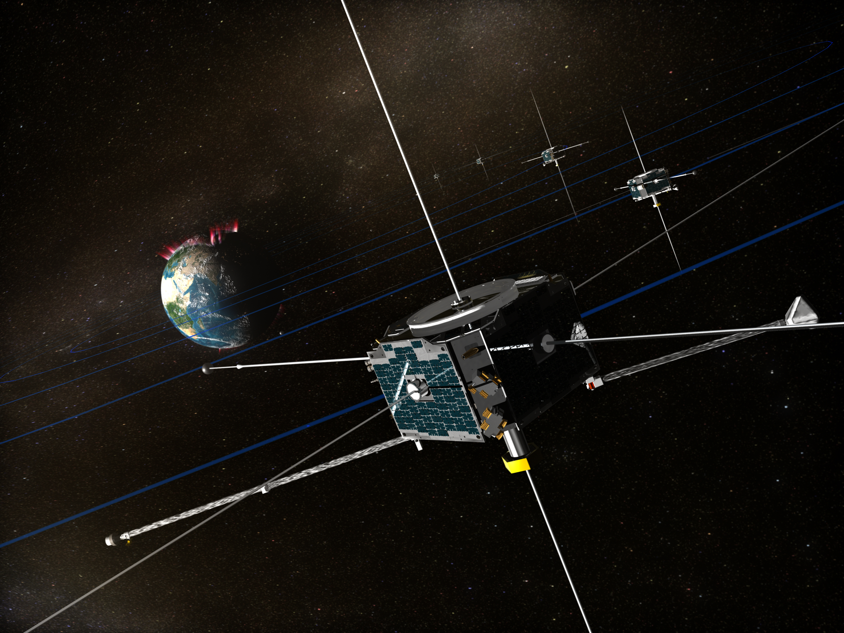
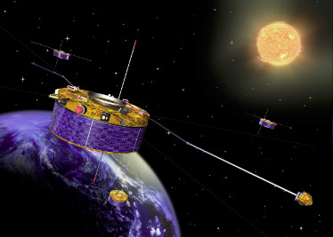
40+ Years of Observations
ISEE (Launched 1977)
WIND (Launched 1994)
THEMIS (Launched 2007)
Cluster (Launched 2000)

Slide 6
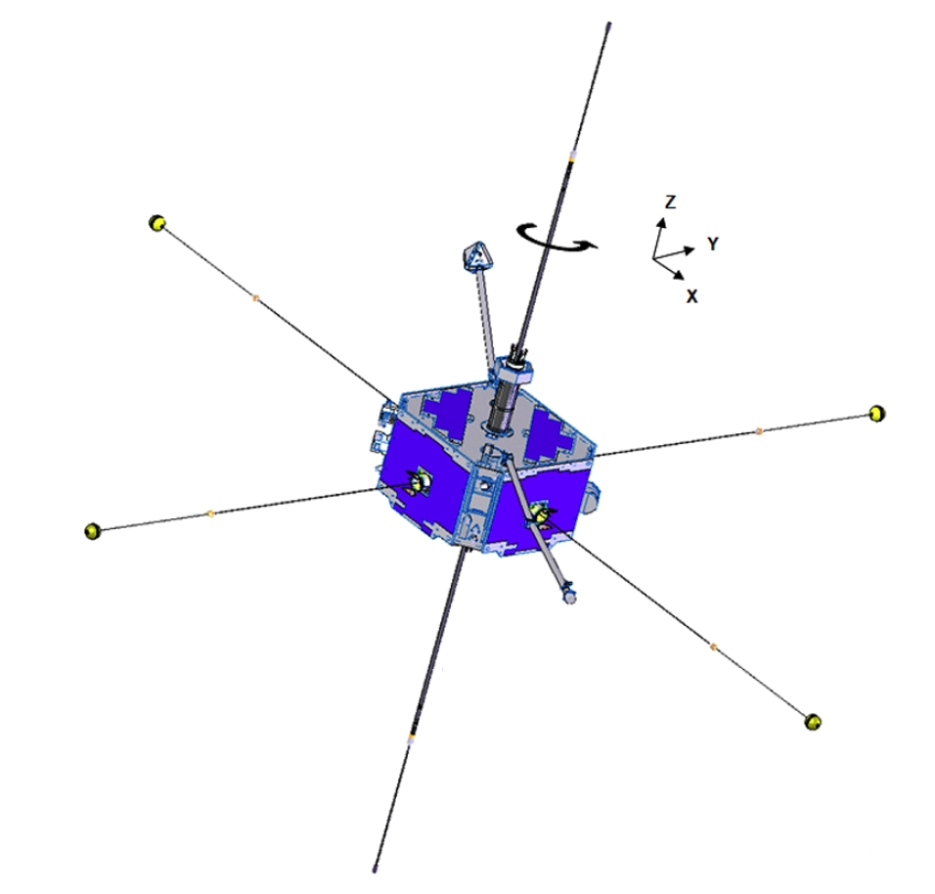
Historical Observation of Shocks
Upstream
Downstream
Upstream and Downstream conditions frequently observed
Easy to observe
Easy to observe
???
Rankine-Hugoniot Conditions:
mass in = mass out
momentum in = momentum out
energy in = energy out
Can estimate what happens inside shock
Shock
  Very hard to observe
Notes:
Mention assumptions inside shock black box.

Slide 7
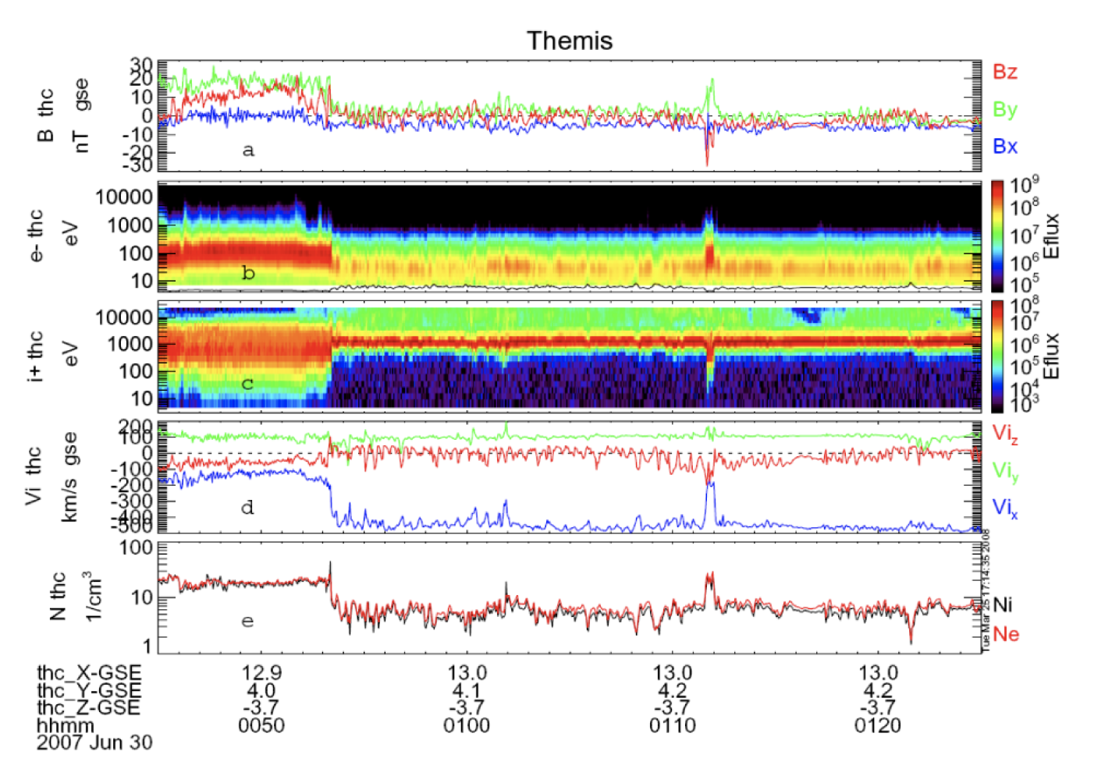
Example From THEMIS
Shock
~80 minutes
~ 1 Sample / 3 seconds
Particle time resolution
Only a few data points of particle data during actual shock
Had to rely on E and B field to observe inside the shock
>1000 Samples / second
Field time resolution
McFadden et al., [2008]

Slide 8
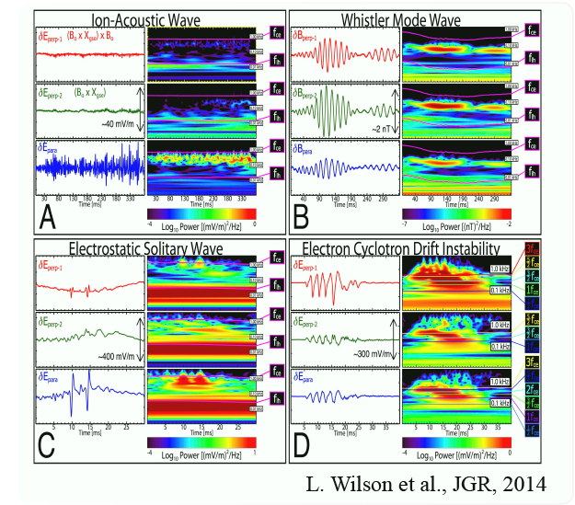
Shocks are Host to Many Wave Modes
Not clear how these waves are generated
Can connect to different microinstabilities like:
  Buneman
  Electron Cyclotron Drift
  Two-stream instability
  Many others
Wave influence on shock dynamics is not clear
Stochastic Heating

Slide 9
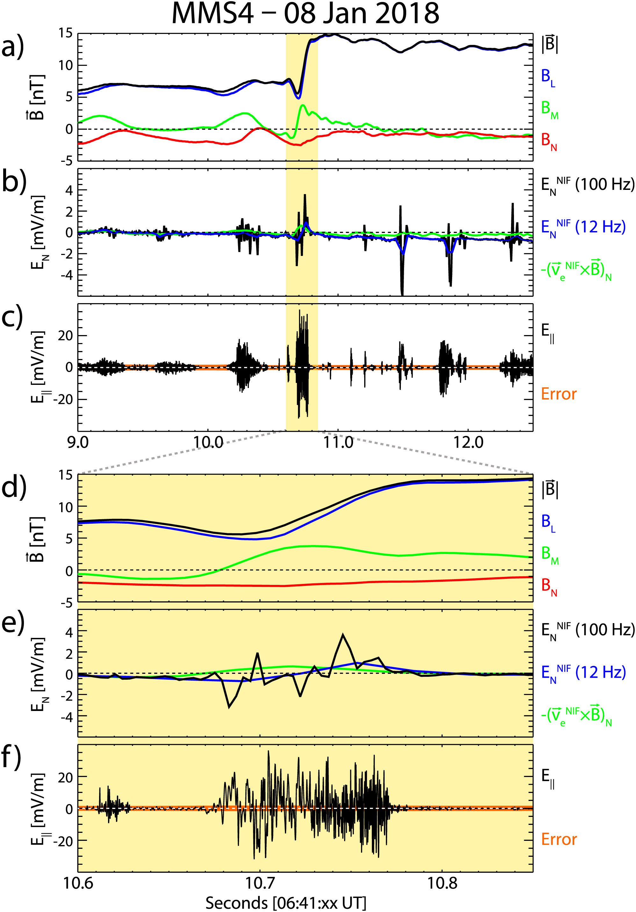
Nonlinear Potentials at IP Shocks
Cohen et al., [2019]
Cross-Shock Potential In Microscale
Nonlinear in Nature
AND
Large amplitude Electrostatic Waves

Slide 10
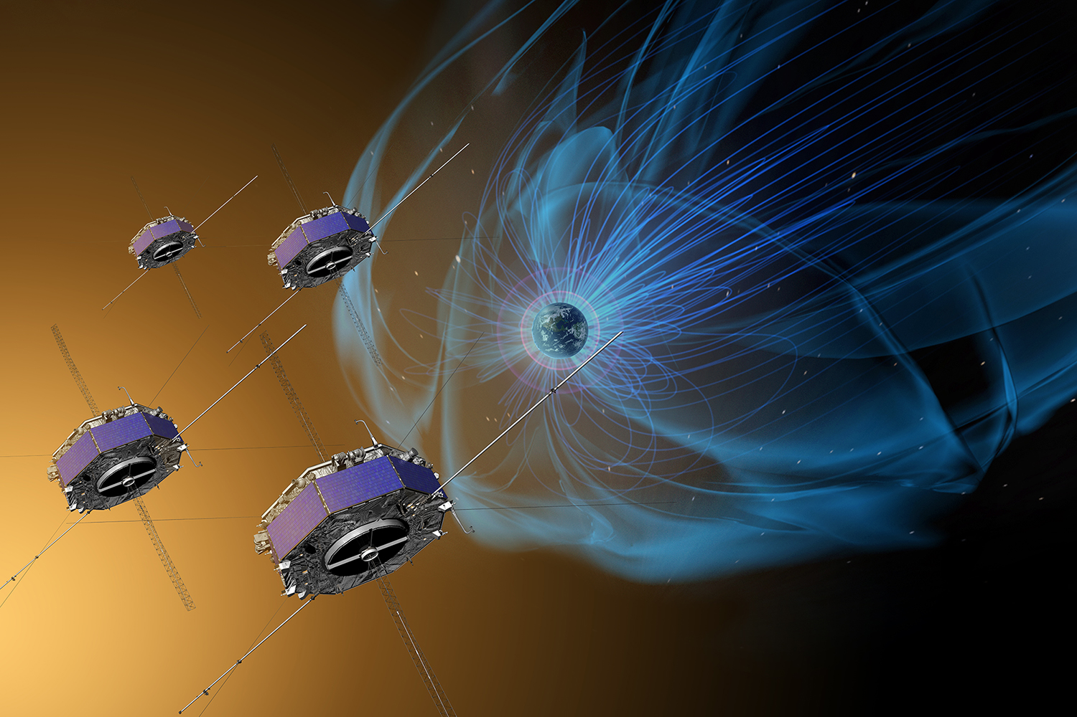
Magnetospheric MultiScale (MMS)
Objective: observe reconnection in magnetosphere
3D Electric Field and Magnetic Field instruments
4 Spacecraft
small separation (10 – 100 km)
high time resolution particle instruments
30 Samples/second electrons
7 Samples/second ions

Slide 11
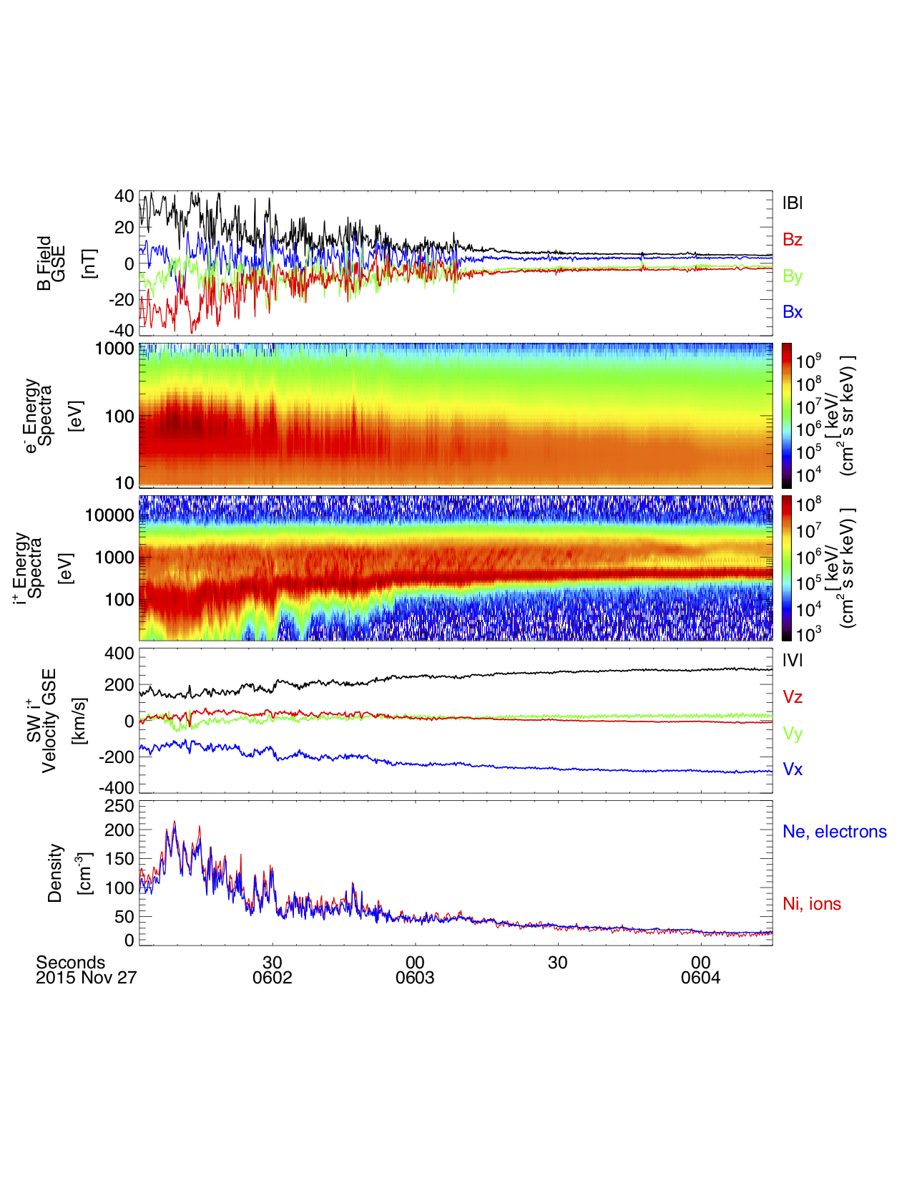
Example From MMS
Shock
~2.25 min
30 Samples/second
7 Samples/second
Particle time resolution
Fine structure seen throughout shock
*Remember, all shocks are different
Apples ≠ Oranges
But it’s a start!
Now we can begin correlating
wave and particle behavior!

Slide 12
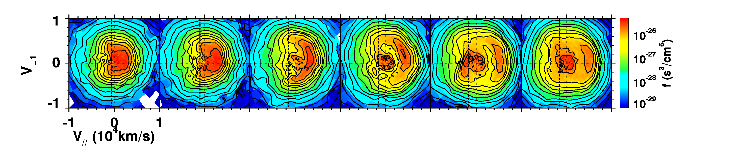
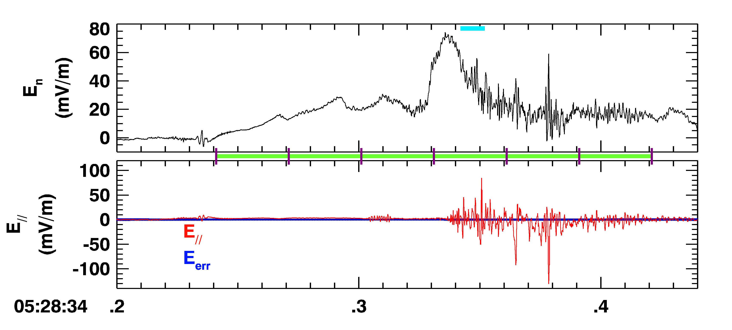
MMS Observations of Waves and Electrons
E|| waves begin to grow as transport of phase-space-density to anti-parallel starts
D
E
Buneman
→
ECDI
→
3D IAWs
in B?
D
E
Chen et al., [2018]

Slide 13
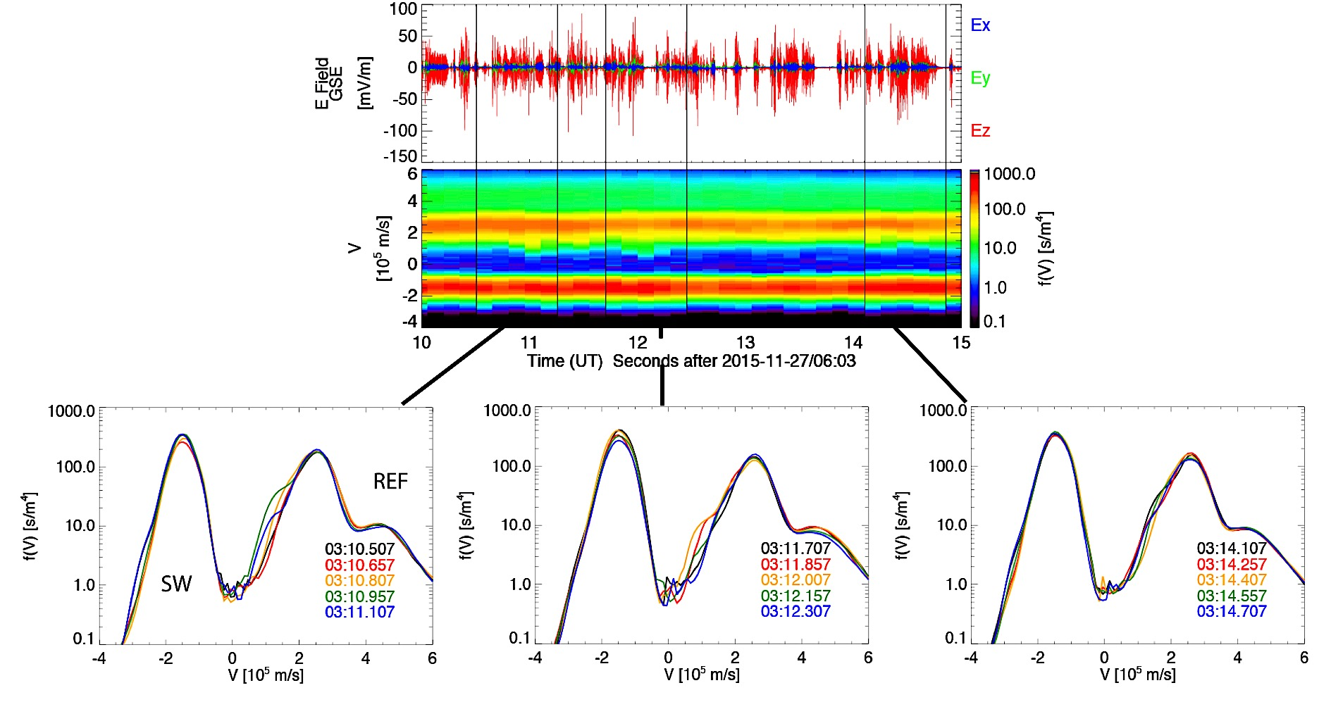
MMS Observations of Waves and Ions
~6 seconds
*f(V) Integrated along vector of least difference between SW and reflected ions
.75 sec
Large variations between 150 ms distributions
Consistent with ion beams

Slide 14
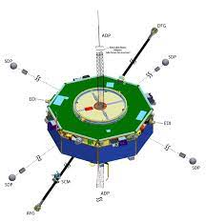
MMS isn’t perfect for Shocks
Upstream
Downstream
???
???
Close Spacecraft Separation
  10– 100 km
Opposite Problem
Can observe electron-scale particle measurements
CANNOT refer to upstream and downstream context
But we could fix that…
  With enough fuel we can fix any orbit
Shock
Notes:
Mention assumptions inside shock black box.

Slide 15
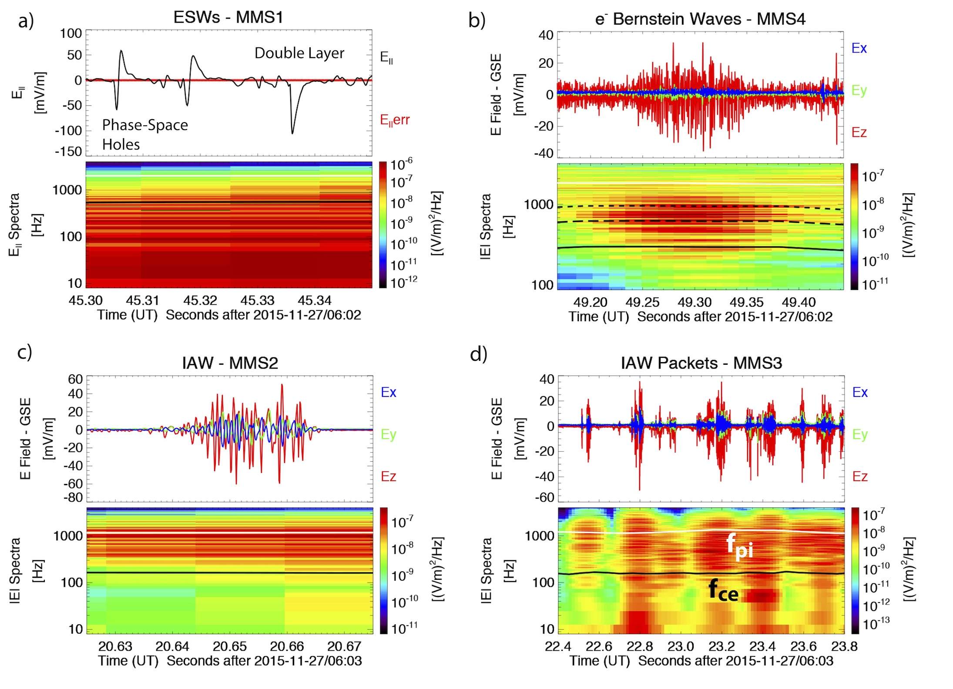
MMS isn’t perfect for shocks…
(sorry)
Electric Field booms are too long!
  Can resolve lower frequency activity
  Higher frequency waves are highly attenuated
  Can be fixed with specialized treatment
SDPs – 120 m tip-to-tip
ADPs – 30 m tip-to-tip
Most HF Electrostatic waves are ~100 m!
V
Good
L
V1
V2
Bad

Slide 16
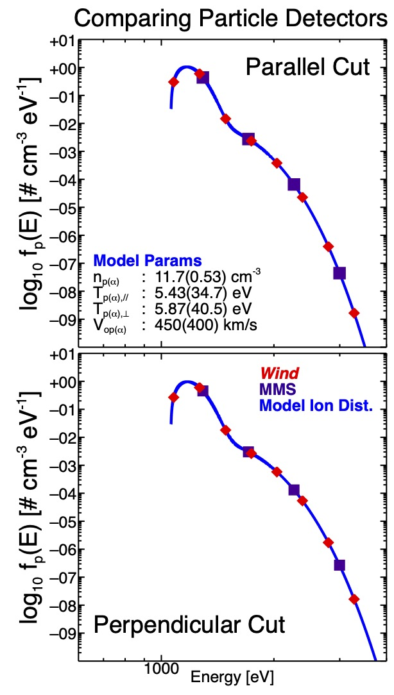
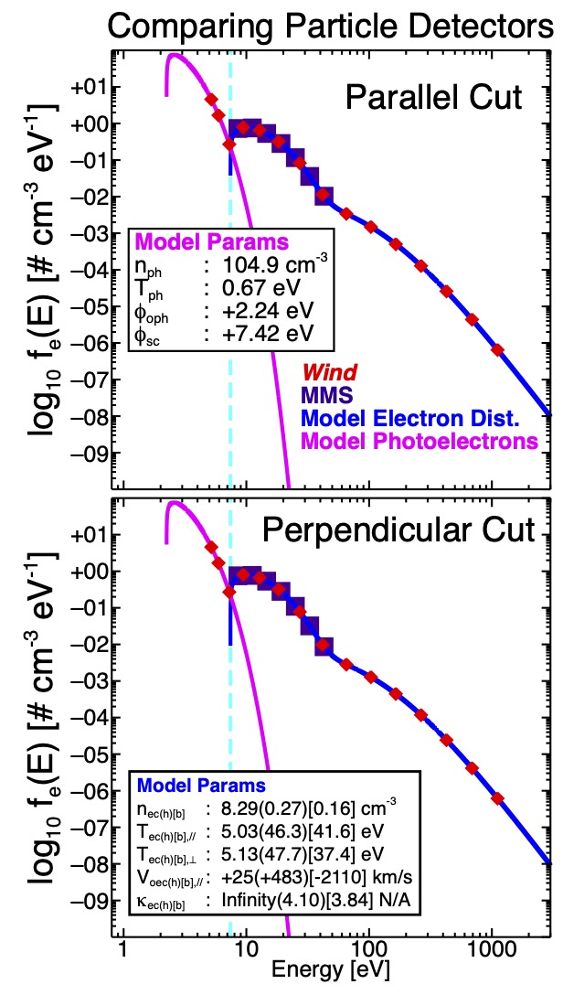
MMS isn’t perfect for shocks…
(sorry)
FPI Energy and Angular Resolution
  Good for some cases, but not all.
  Need the right conditions (high enough density and temperature)
  Not optimized for solar wind (hard to differentiate core, halo, strahl)
Protons
Electrons

Slide 17
NONE of These Spacecraft Targeted Shock Science (except ISEE)
ISEE (Launched 1977)
WIND (Launched 1994)
THEMIS (Launched 2007)
Cluster (Launched 2000)

Slide 18

If You REALLY Want to Study Shocks…
OR a specifically designed spacecraft mission...

Slide 19

MAKOS – Multi-point Assessment of the Kinematics Of Shocks
Science Questions:
Heliophysics Mission Concept Study
What is the energy budget on either side of a collisionless shock?
  Measure all dominant forms of energy upstream and downstream of the bow shock
  Upstream and downstream measurements taken simultaneously from at least two spacecraft
What are the processes governing energy conversion at & within collisionless shocks?
  Observe electromagnetic fields and particle populations within the shock layer
How & why do these processes vary with shock orientation and driving conditions?
To Be Submitted to the 2024 Heliophysics Decadal Survey
Katherine.Goodrich@mail.wvu.edu

Slide 20
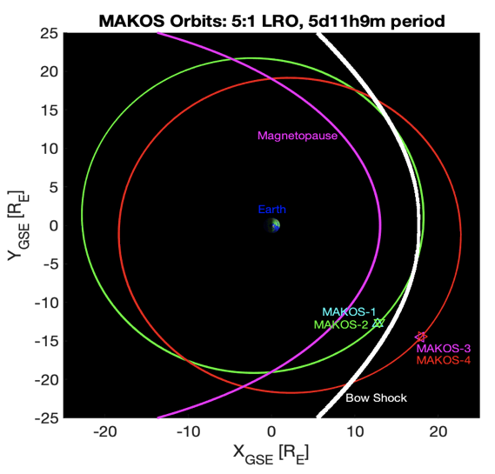
Mission Orbit Design
4 identically-instrumented small satellites to probe both ion kinetic and MHD spatial scales simultaneously
Lunar resonant orbit;
2 co-planar orbits
  Orbit maximizes number of bow shock crossings (>100/year)
  Dwell time in
  solar wind to capture potential IP shocks
Several RE (MHD scales)
1
2
3
4
100s km (ion kinetic)
100s km (ion kinetic)

Slide 21
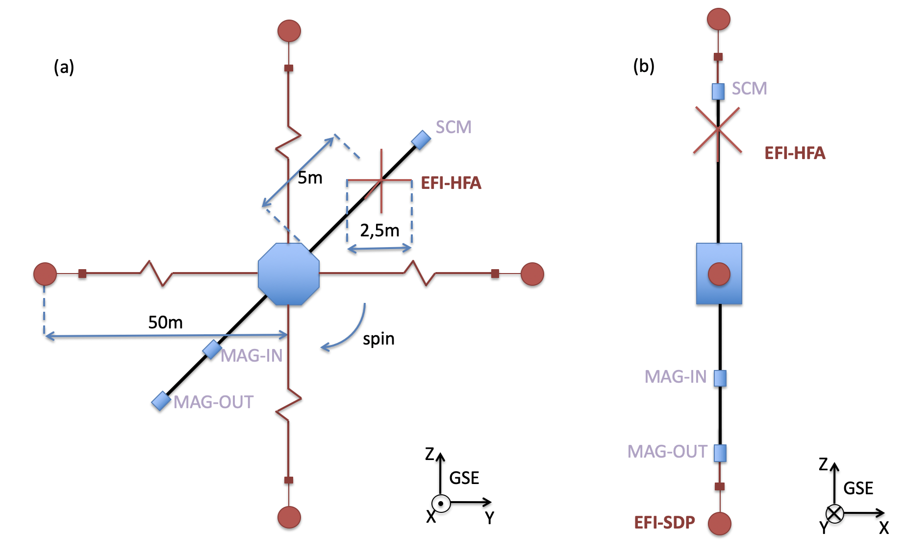
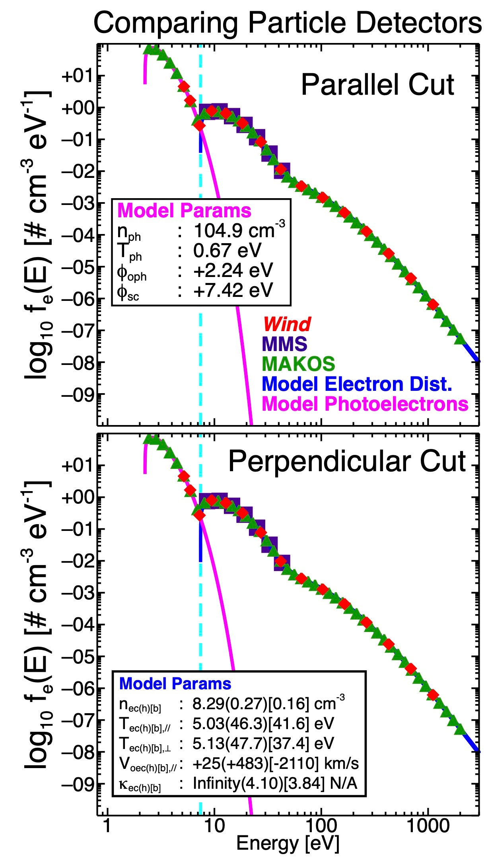
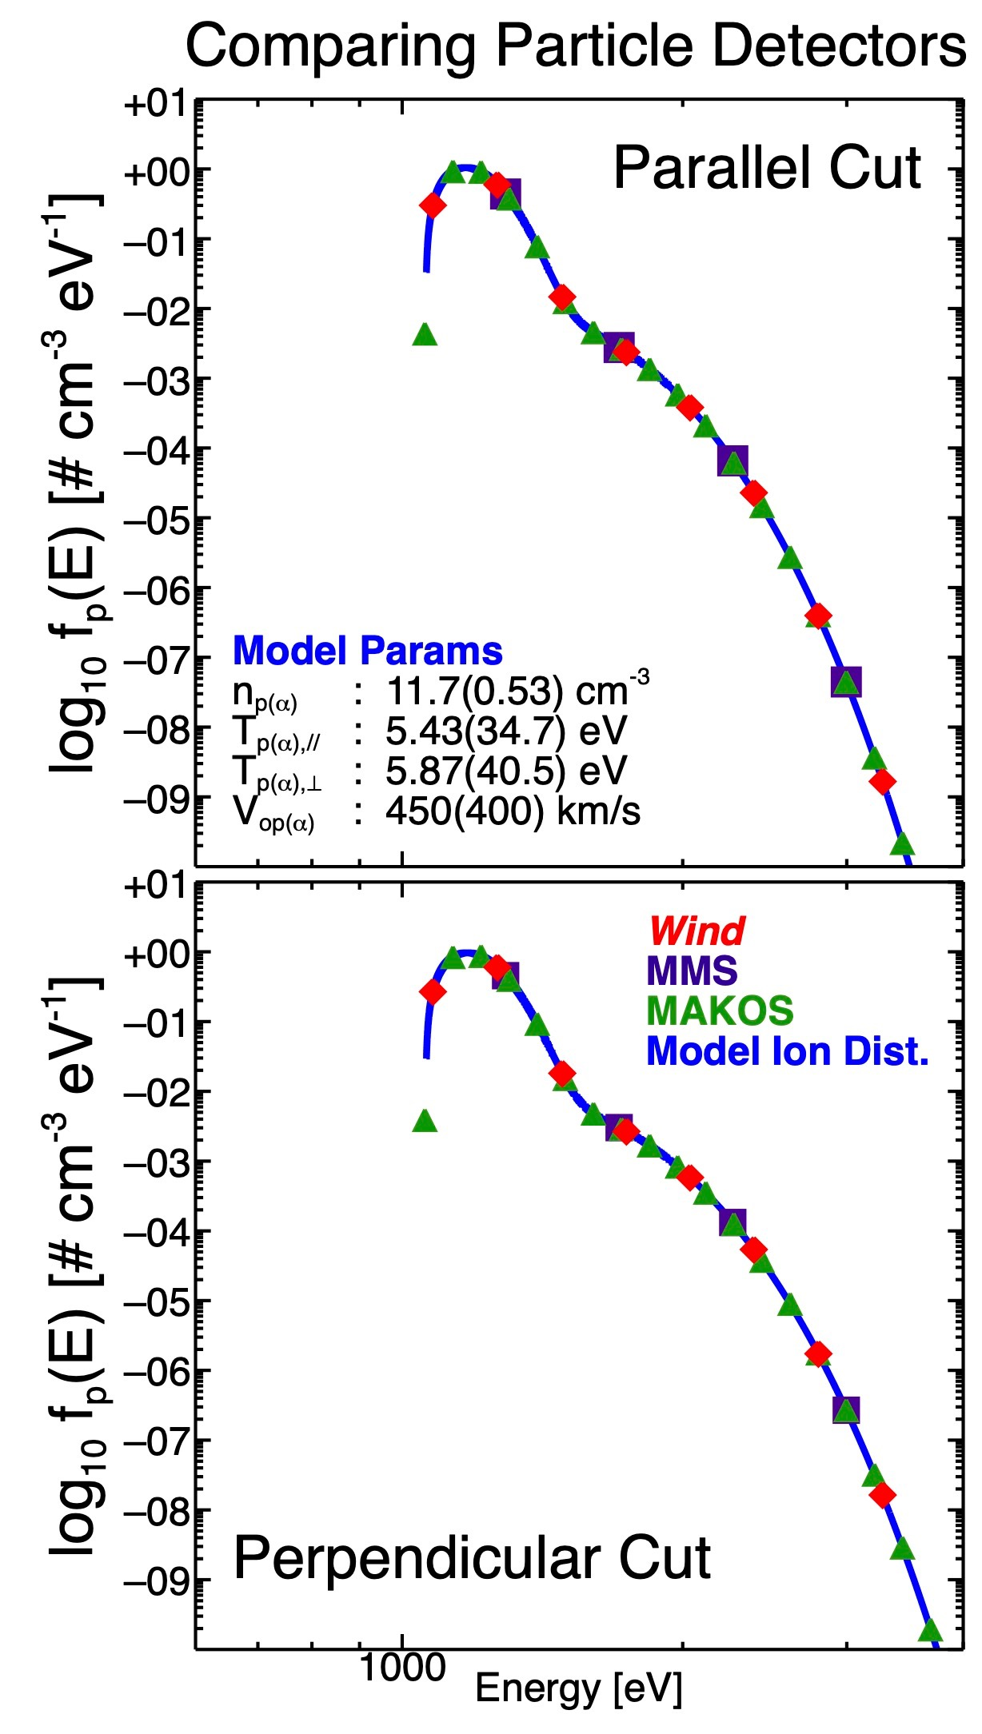
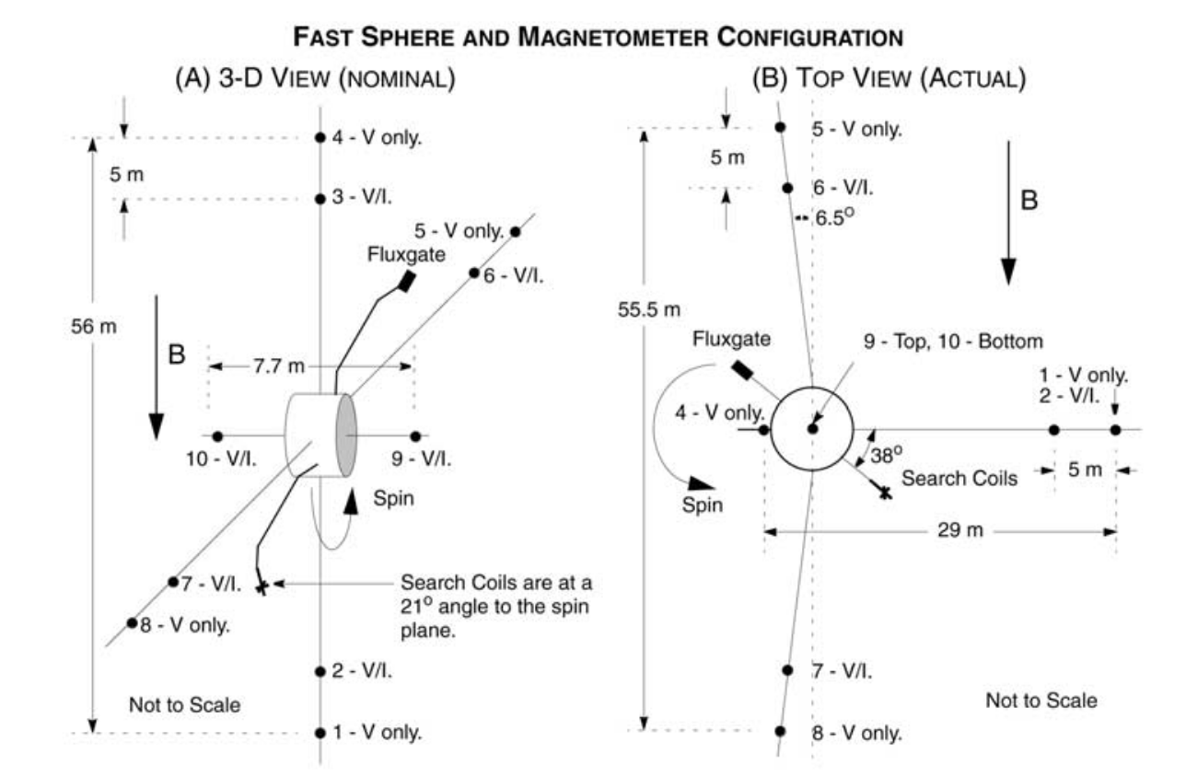
MAKOS Instrument Payload
THOR

Slide 22
MAKOS Team
Principal Investigator
  Katherine Goodrich – West Virginia University
Science Team Members
  Drew Turner – Applied Physics Laboratory
  Ian Cohen – Applied Physics Laboratory
  Lynn Wilson ||| - Goddard Space Flight Center
  Steven Schwartz – CU Boulder/Imperial College
Mission and Spacecraft Design Team – SwRI
  Amir Caspi
  Keith Smith
  Randy Rose
Collaborators
  Phyllis Whittlesey – Space Sciences Laboratory
  Ferdinand Plaschke – Technische Universität Braunschweig
Interested in Showing Support? Want to learn more?
Katherine.Goodrich@mail.wvu.edu

Slide 23
How Do YOU Want to Observe Shocks?
N spacecraft constellations are great
  Large spatial coverage
  Excellent overall context
  Low resolution instruments
  Bad kinetic plasma physics coverage
Specialized, high-cadence instrumentation spacecraft are also great
  Localized spatial coverage
  Not the best overall context
  High resolution instruments
  Excellent kinetic plasma physics coverage
We need to pursue BOTH when measuring space plasma
DON’T FORGET KINETIC PHYSICS

