Slide 1

Turbulence and large-scale structures in the expanding solar wind
Chen Shi (时辰)
University of California, Los Angeles
Marco Velli, Anna Tenerani, Victor Réville, et al.

Slide 2
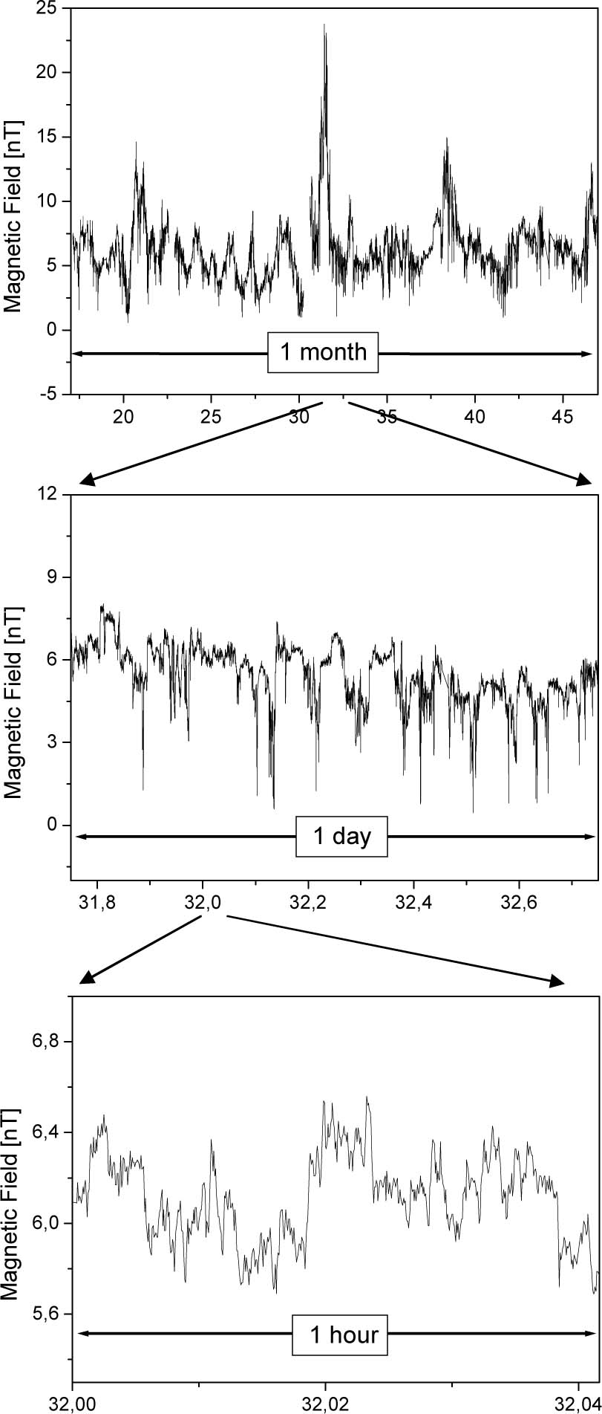
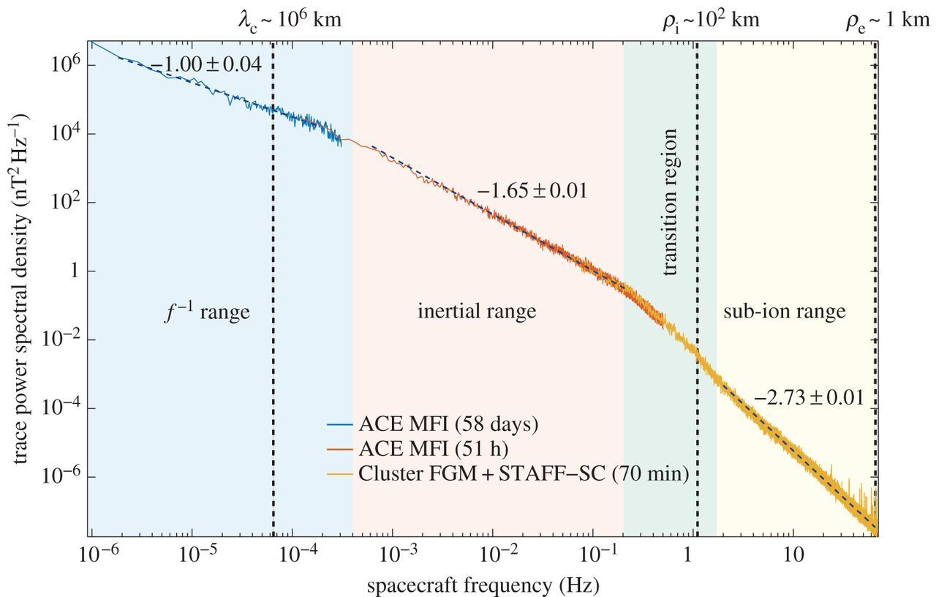
Turbulence in the solar wind
Heating/acceleration of the solar wind
Energetic particles
Origin of the solar wind
Fundamental nonlinear plasma physics
Energy cascade
Energy-containing
scales
Dissipation
scales
(Kiyani+2015)
(Bruno and Carbone, 2013)

Slide 3
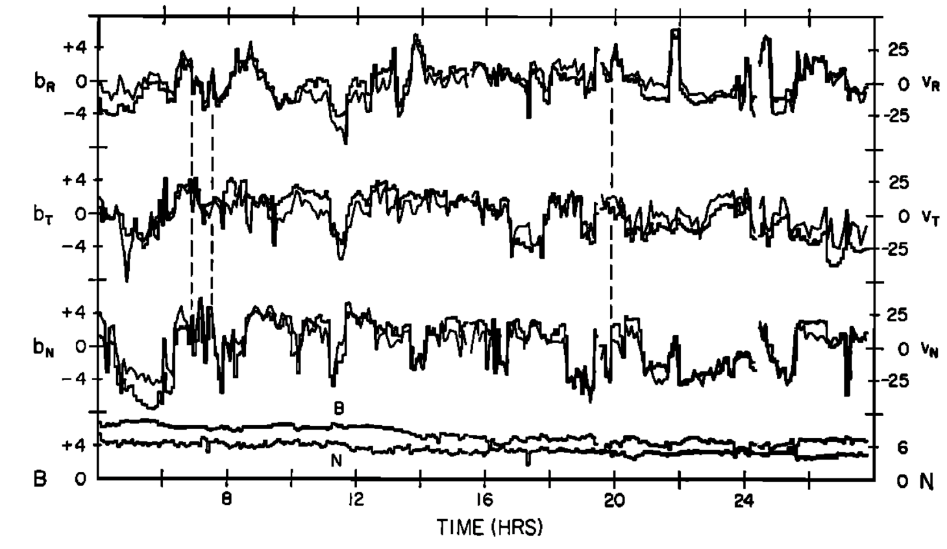





Turbulence in the solar wind at MHD scales
Highly-correlated $v−b$
Outward-propagating Alfvén waves
Negative $B_{R}$
Fluctuations in $V\&B$
Elsässer variables:
$$z^{±}=u_{1}±\frac{b_{1}}{\sqrt{4πρ}}$$
$$\left|B\right|\&N$$
(Belcher and Davis, 1971)
inward/outward Alfvén waves
Incompressible

Slide 4
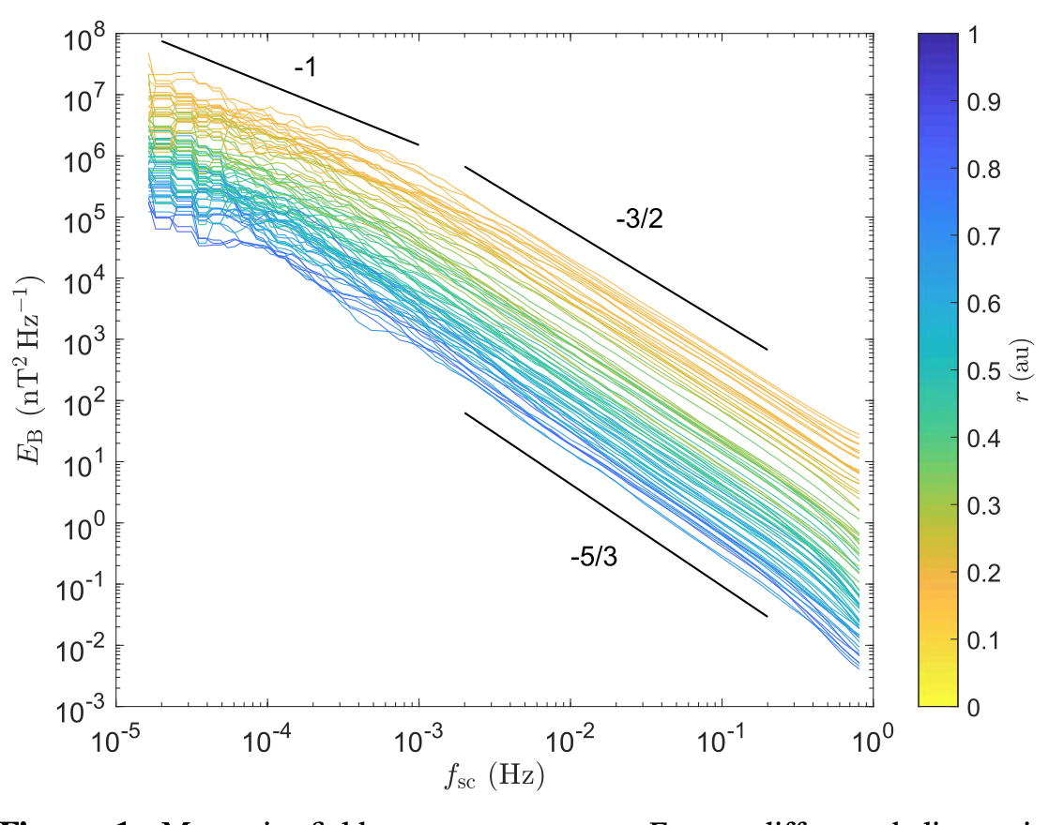
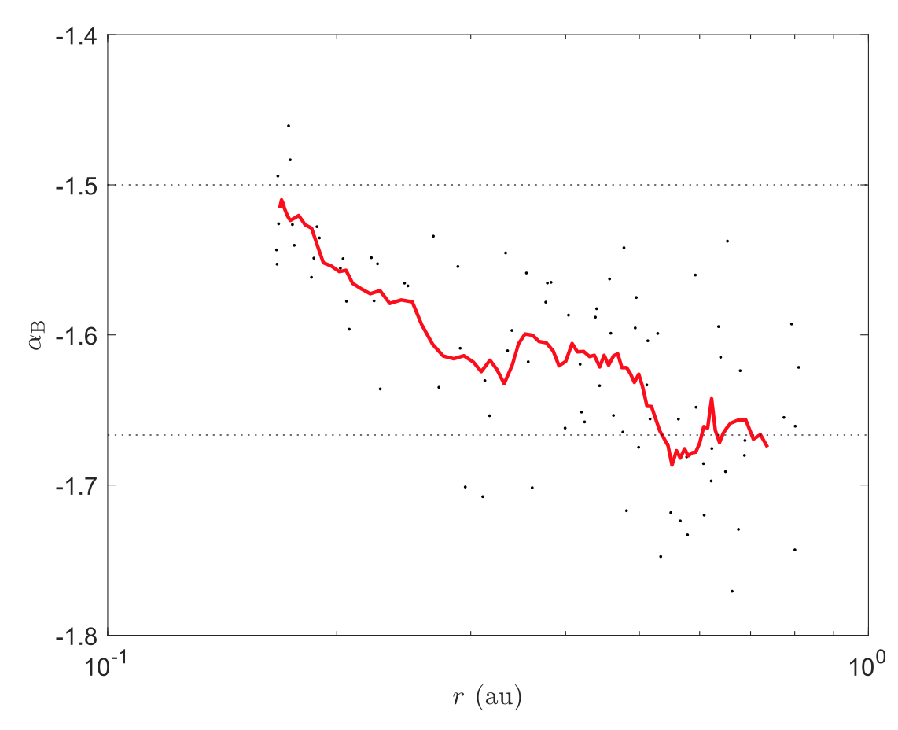

Turbulence is dynamically evolving in the solar wind
Nonlinear process: $z^{±}⋅∇z^{∓}$
Radial evolution of the power spectra
Magnetic field power spectrum
Slope of the spectrum
Chen+2020

Slide 5
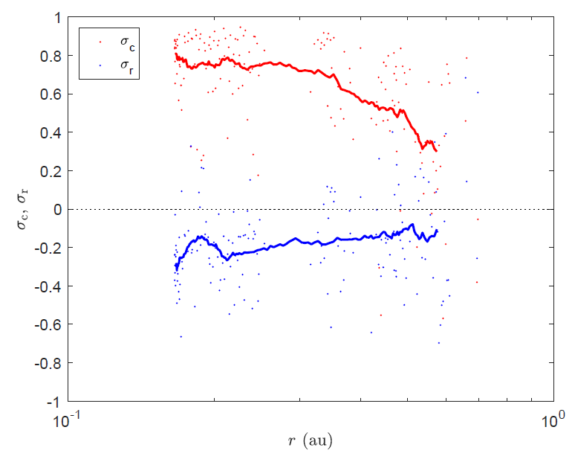
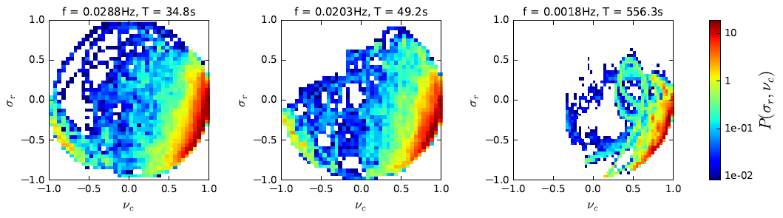



Alfvénicity
Normalized cross helicity
$σ_{c}=\frac{{\left|z_{o}\right|}^{2}−{\left|z_{i}\right|}^{2}}{{\left|z_{o}\right|}^{2}+{\left|z_{i}\right|}^{2}}$
$σ_{c}=1$: pure outward wave; $σ_{c}=−1$: pure inward wave
Normalized residual energy
$σ_{r}=\frac{{\left|u\right|}^{2}−{\left|v_{A}\right|}^{2}}{{\left|u\right|}^{2}+{\left|v_{A}\right|}^{2}}$
$σ_{r}=1$: pure kinetic energy; $σ_{r}=−1$: pure magnetic energy
$$σ_{c}$$
$$σ_{r}$$
McManus+2020
Chen+2020

Slide 6
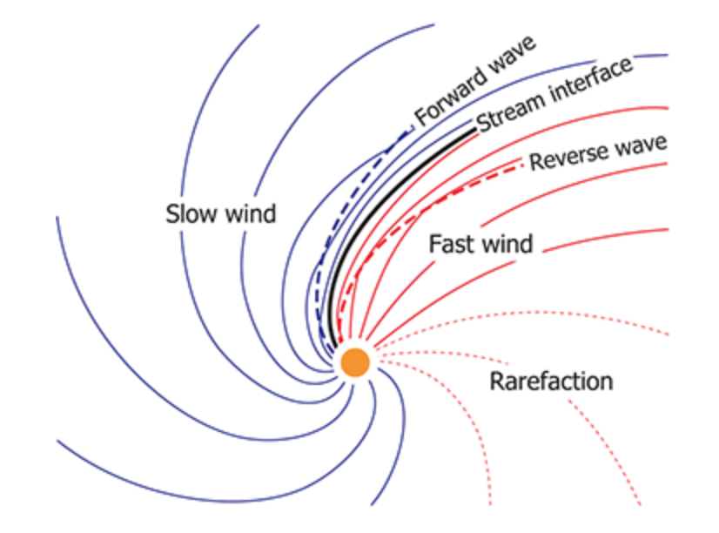
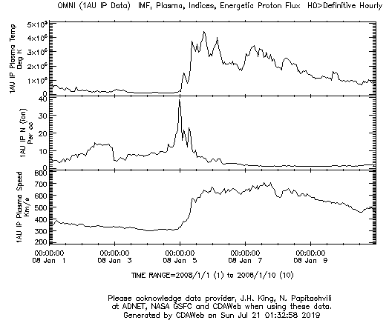



stream interaction region (SIR)
compression region
$$T/K$$
slow wind
$$n/cm^{−3}$$
fast wind
$$v/km⋅s^{−1}$$
Illustration of the stream interaction region
Owens and Forsyth (2013)

Slide 7
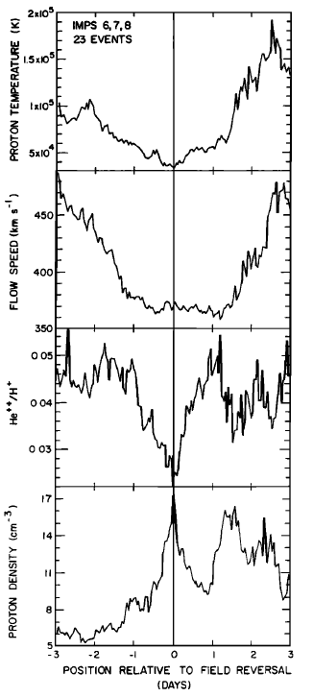
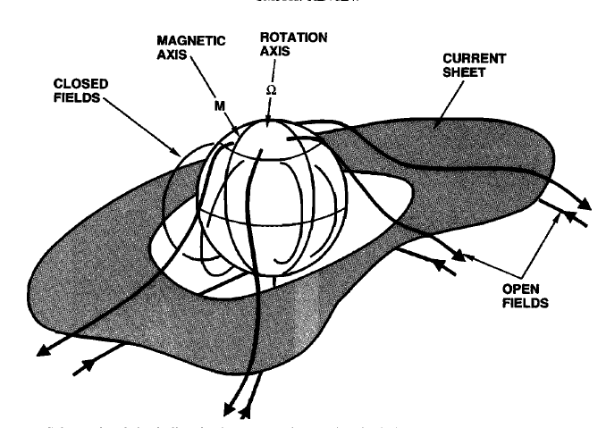



heliospheric current sheet (HCS)
Polarity-reversal surface
$$T/K$$
$$v/km⋅s^{−1}$$
He⁺⁺/H⁺
$$n/cm^{−3}$$
Illustration of heliospheric current sheet (Smith, 2001)

Slide 8
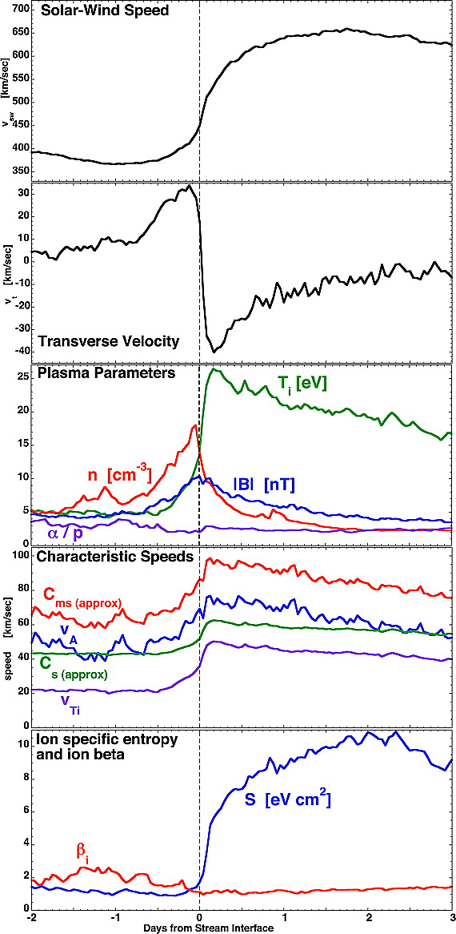
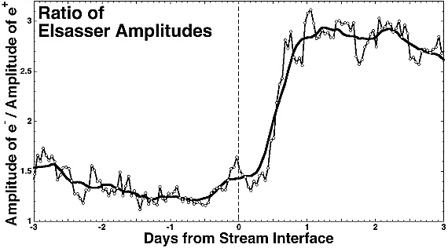
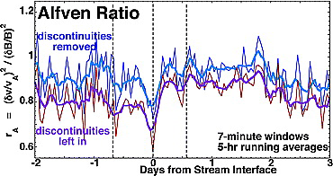


OMNI2 (1AU data) of SIRs
Superposed epoch analysis of 27 corotating interaction region crossings using OMNI data
$$z_{out}/z_{in}$$
peak
More outward waves
$$δv/δb$$
(Borovsky and Denton, 2010)
drop
More magnetic energy

Slide 9
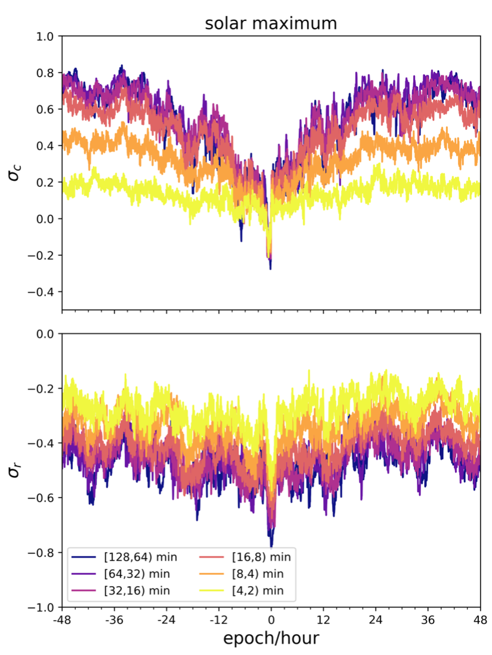
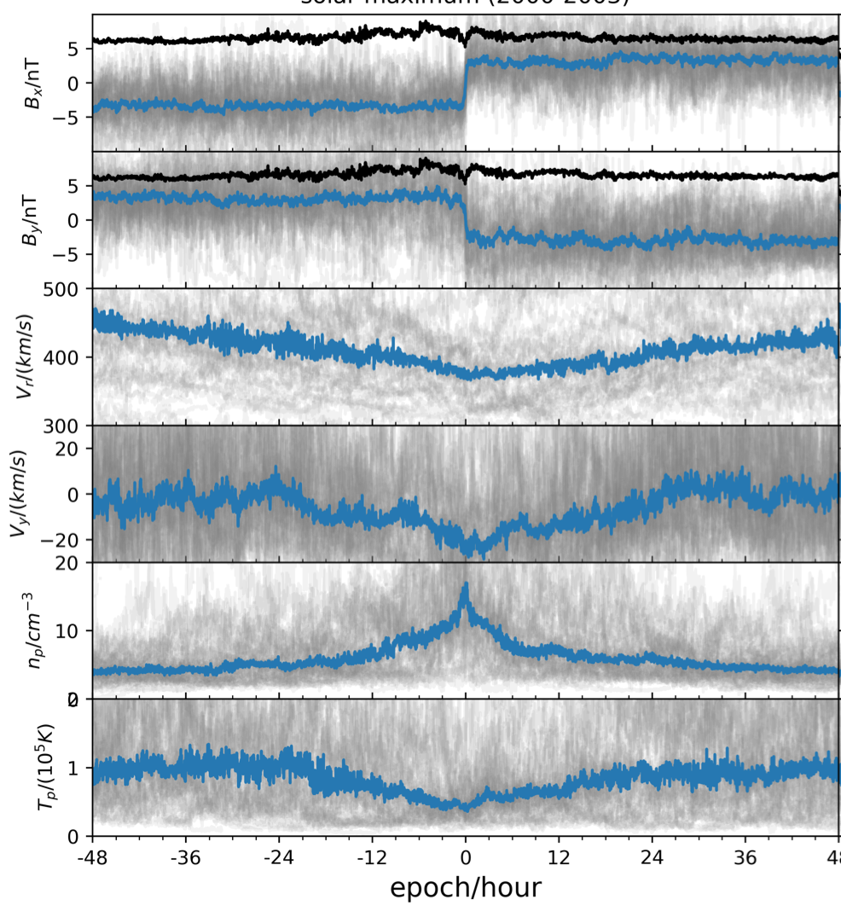
OMNI2 (1AU data) of HCS
48 HCS crossings
Magnetic field
Radial speed
transverse speed
density
temperature
Shi+2022

Slide 10
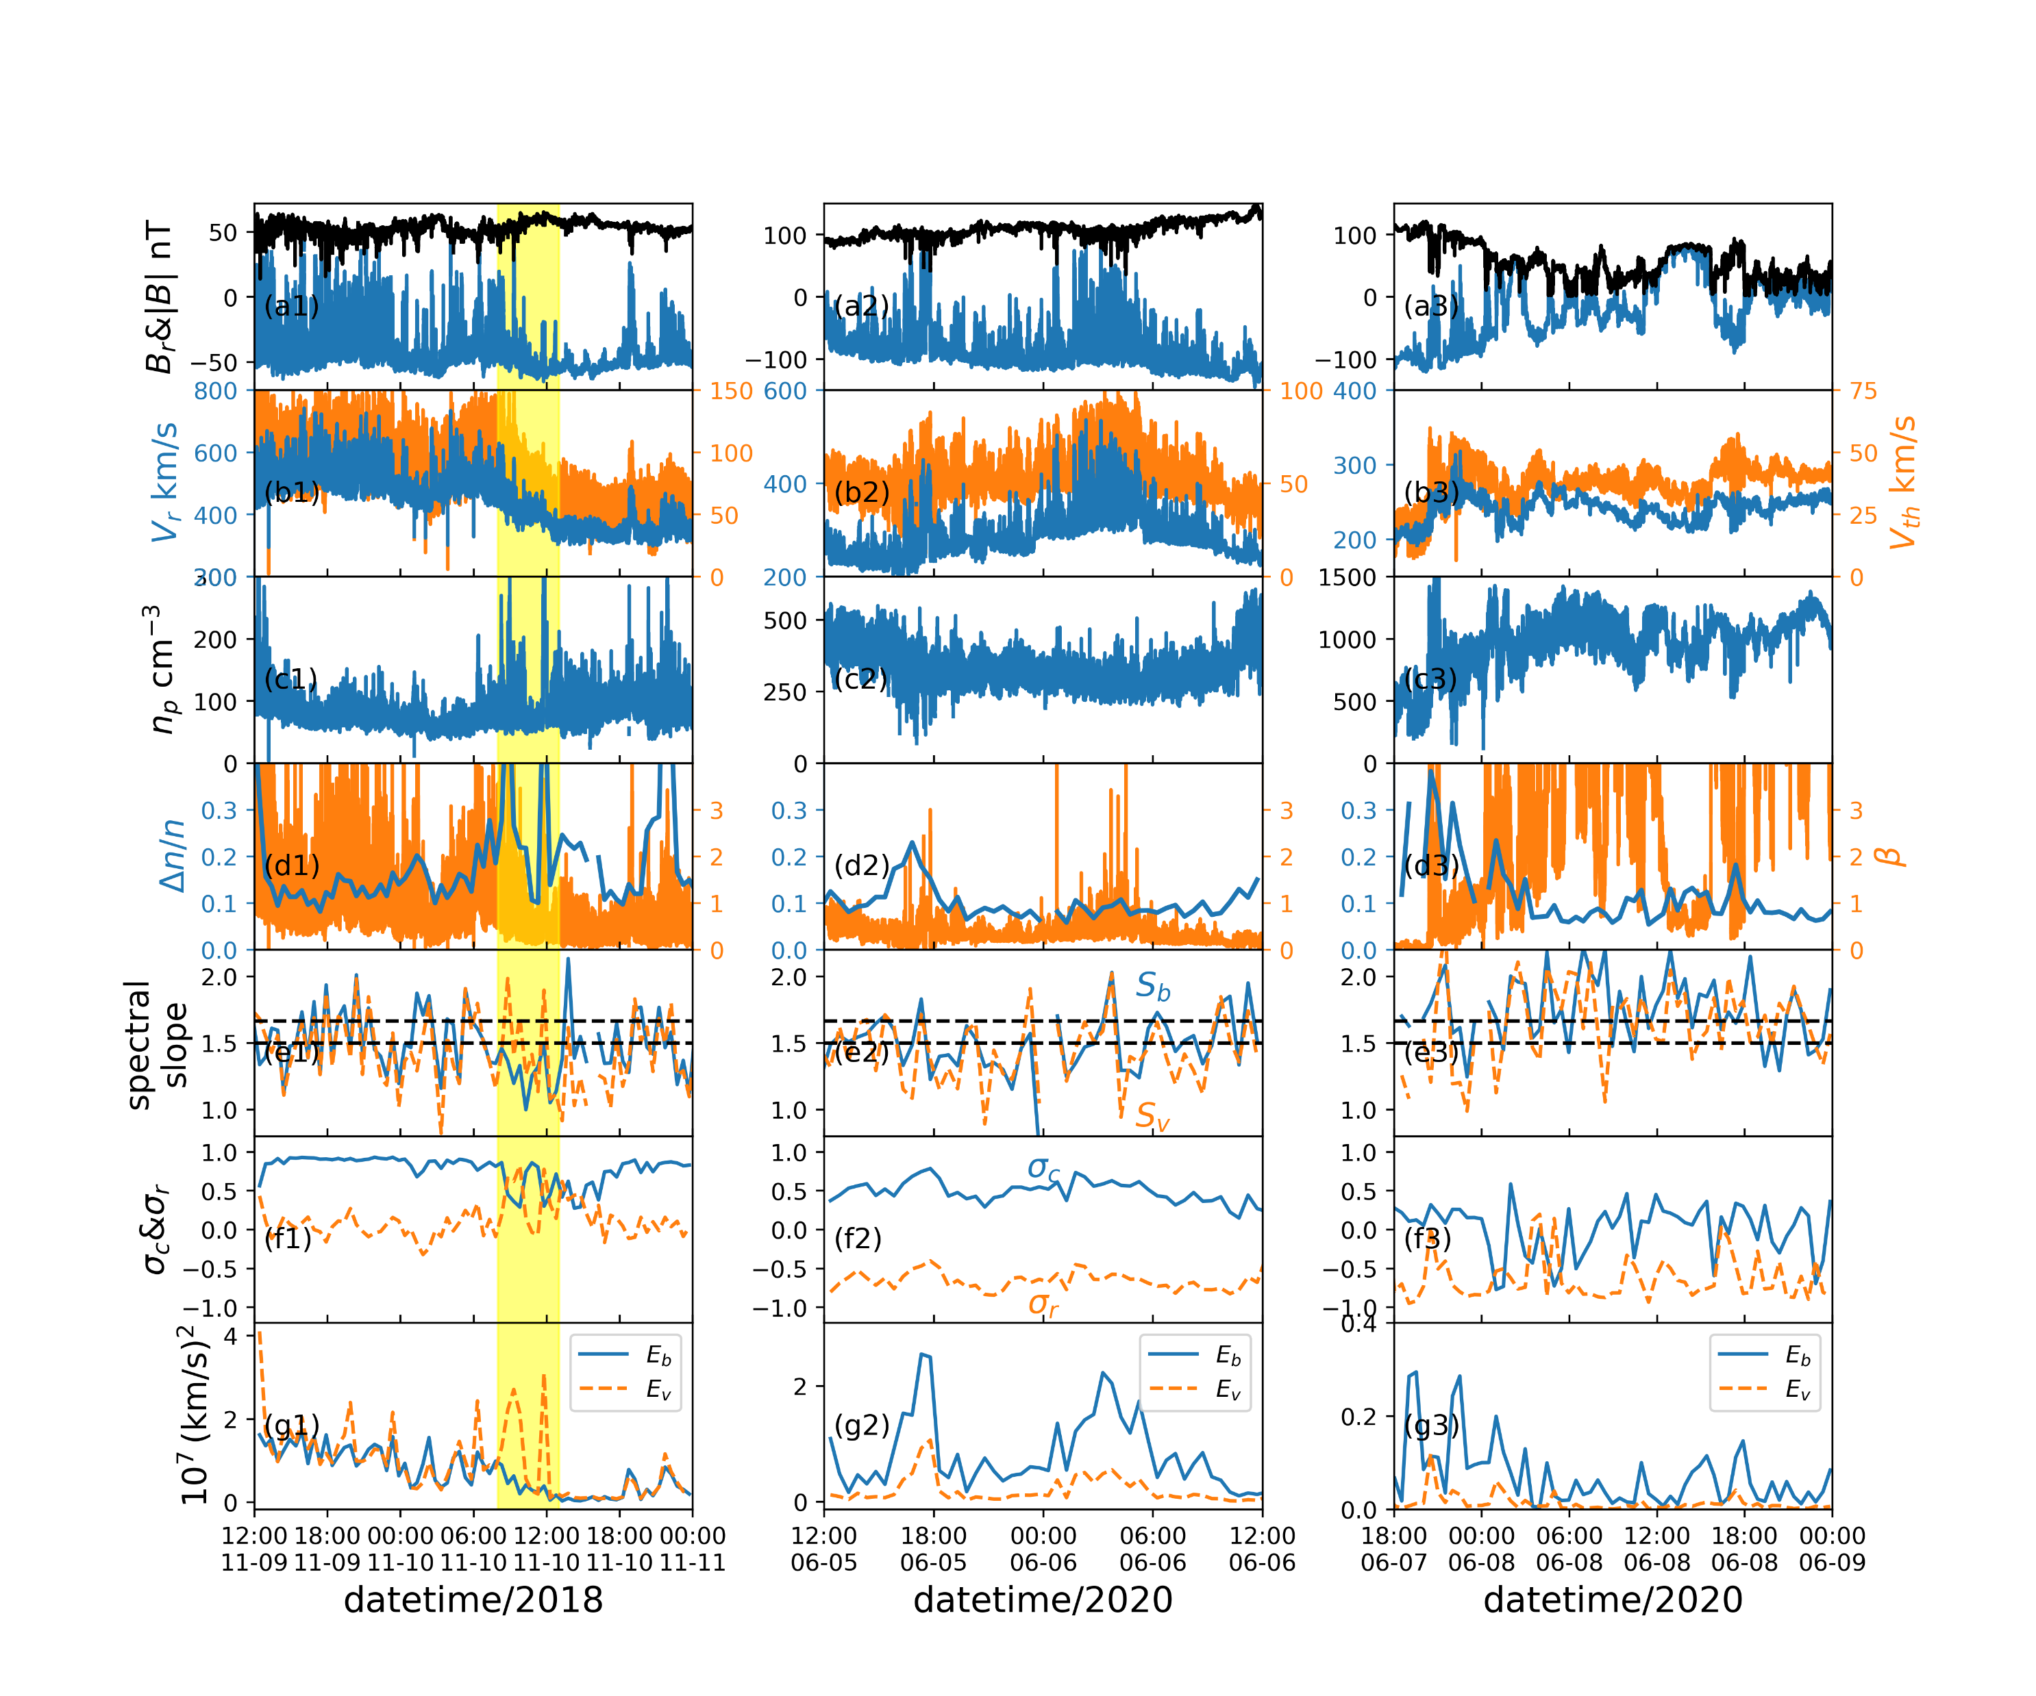



Parker Solar Probe observations
Shi+2021
stream shear
HCS
radial magnetic field
Stream shear: $σ_{c}↓$, $σ_{r}↑$
HCS: $σ_{c}∼0$, $σ_{r}∼−1$
radial velocity
$$σ_{c}$$
$$σ_{r}$$

Slide 11

Numerical simulation – expanding-box-model (EBM)
Why we need it:
Solar wind is spherically expanding & unable to do global simulations
Expansion: inhomogeneity of the background fields
Expansion: anisotropy between radial/transverse directions
How we do it:
A rectangular box moving with the radial mean flow
Angular size of the box is constant
Neglect high-order curvatures and assume Cartesian coordinates locally
$$U=U_{0}+u=U_{r}{\hat{e}}_{r}+u$$
$$U_{x}≈u_{x}+U_{0}$$
$$U_{y}≈u_{y}+U_{0}\frac{y}{R(t)}$$
$$U_{z}≈u_{z}+U_{0}\frac{z}{R(t)}$$
Tenerani and Velli, 2017

Slide 12




Numerical simulation – expanding-box-model (EBM)
Translation and normalization: $\tilde{x}=x−R\left(t\right),\tilde{y}=\frac{R_{0}}{R\left(t\right)}y,\tilde{z}=\frac{R_{0}}{R(t)}z$
$$\frac{∂ρ}{∂t}+∇⋅\left(ρu\right)=−2\frac{ρ}{τ}$$
$$\frac{∂p}{∂t}+u⋅∇p+κp\left(∇⋅u\right)=−2κ\frac{p}{τ}$$
$$ρ\left(\frac{∂u}{∂t}+u⋅∇u\right)+∇p^{T}−B⋅∇B=−\frac{ρ}{τ}\left(\begin{matrix}0 & 0 & 0 \\ 0 & 1 & 0 \\ 0 & 0 & 1\end{matrix}\right)u$$
$$\frac{∂B}{∂t}+∇×(u×B)=−\frac{1}{τ}\left(\begin{matrix}2 & 0 & 0 \\ 0 & 1 & 0 \\ 0 & 0 & 1\end{matrix}\right)B$$
$$∇=\left(\frac{1}{∂\tilde{x}},\frac{R_{0}}{R\left(t\right)}\frac{∂}{∂\tilde{y}},\frac{R_{0}}{R\left(t\right)}\frac{∂}{∂\tilde{z}}\right), τ=\frac{R\left(t\right)}{U_{r}}$$
$$ρ∝t^{−2}$$
$$p∝t^{−2κ}$$
$$u_{θ,φ}∝t^{−1}$$
$$B_{r}∝t^{−2}$$
$$B_{θ,φ}∝t^{−1}$$
$$ρ∝r^{−2}$$
$$p∝r^{−2κ}$$
$$u_{θ,φ}∝r^{−1}$$
$$B_{r}∝r^{−2}$$
$$B_{θ,φ}∝r^{−1}$$
The radial inhomogeneity becomes the temporal decay

Slide 13
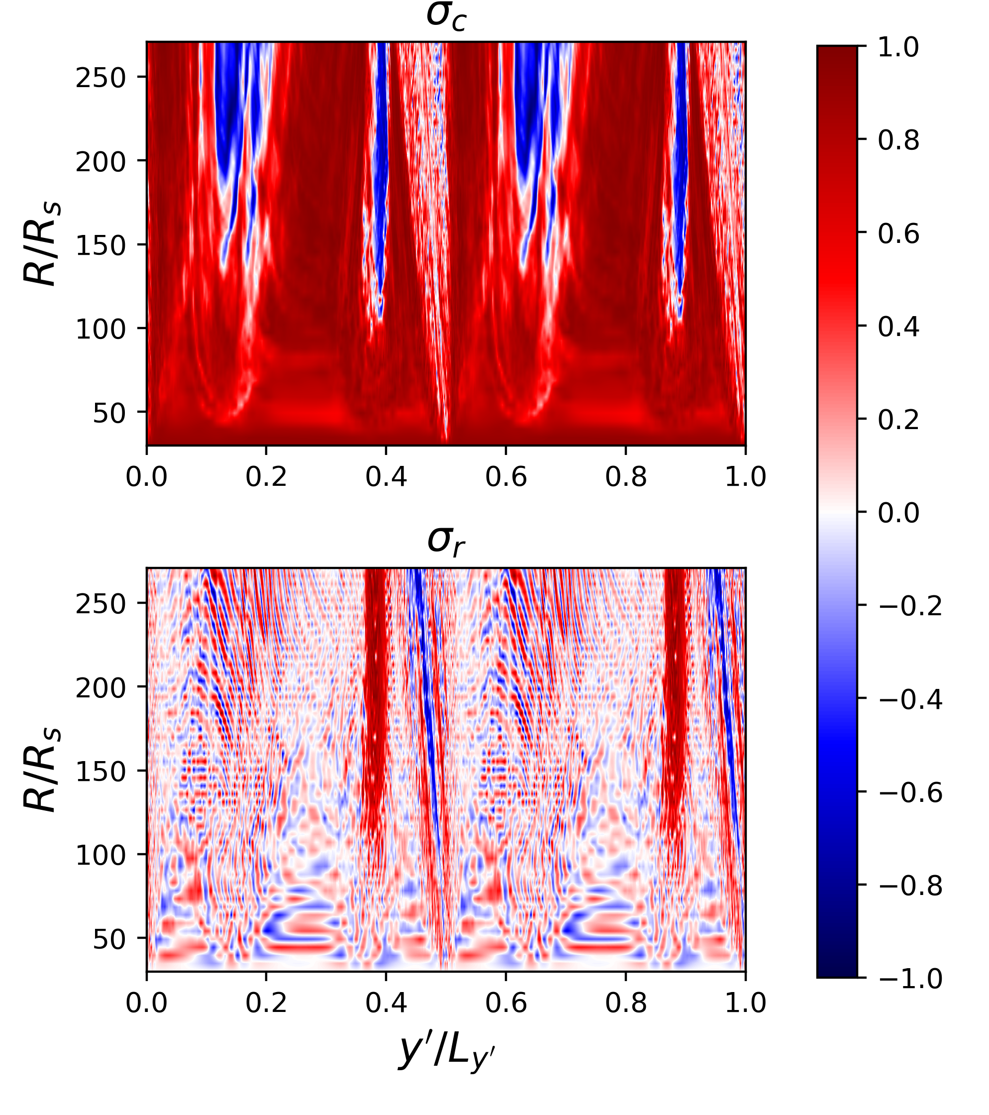
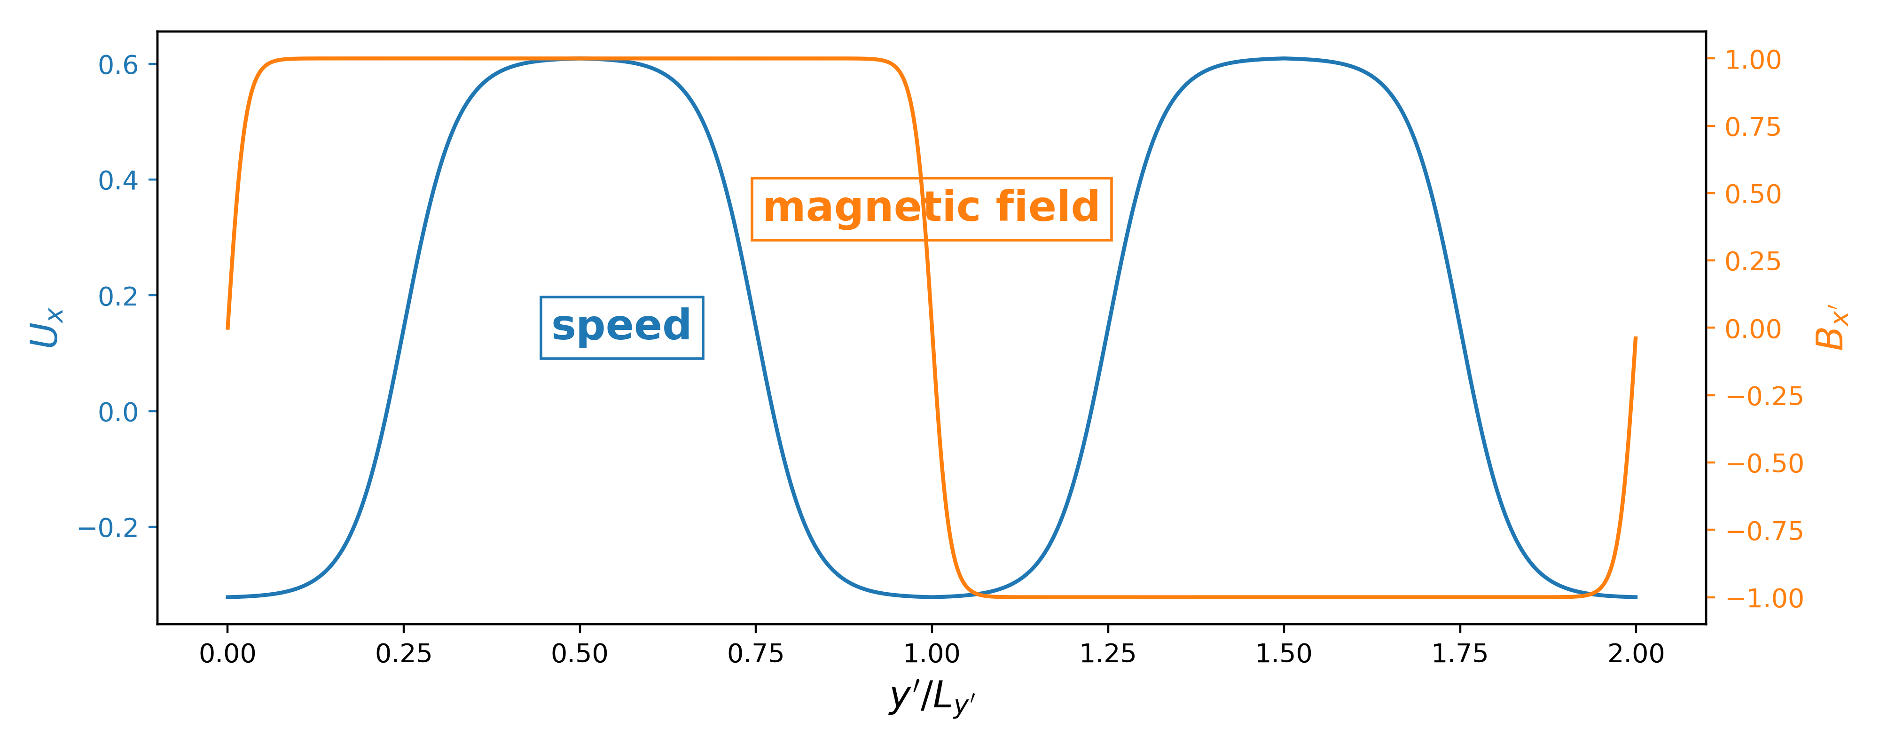






2D EBM-MHD run
$T∈\left[38,75\right]$ min
domain: full circle $× 10R_{s}$
Sim. domain
Longitude
Starts from 30 $R_{s}$
Initially: $z_{in}=0.2z_{out}$
$δb∼0.2B_{0}$
$$β=0.2$$
Longitude
Shi+2020,2022

Slide 14
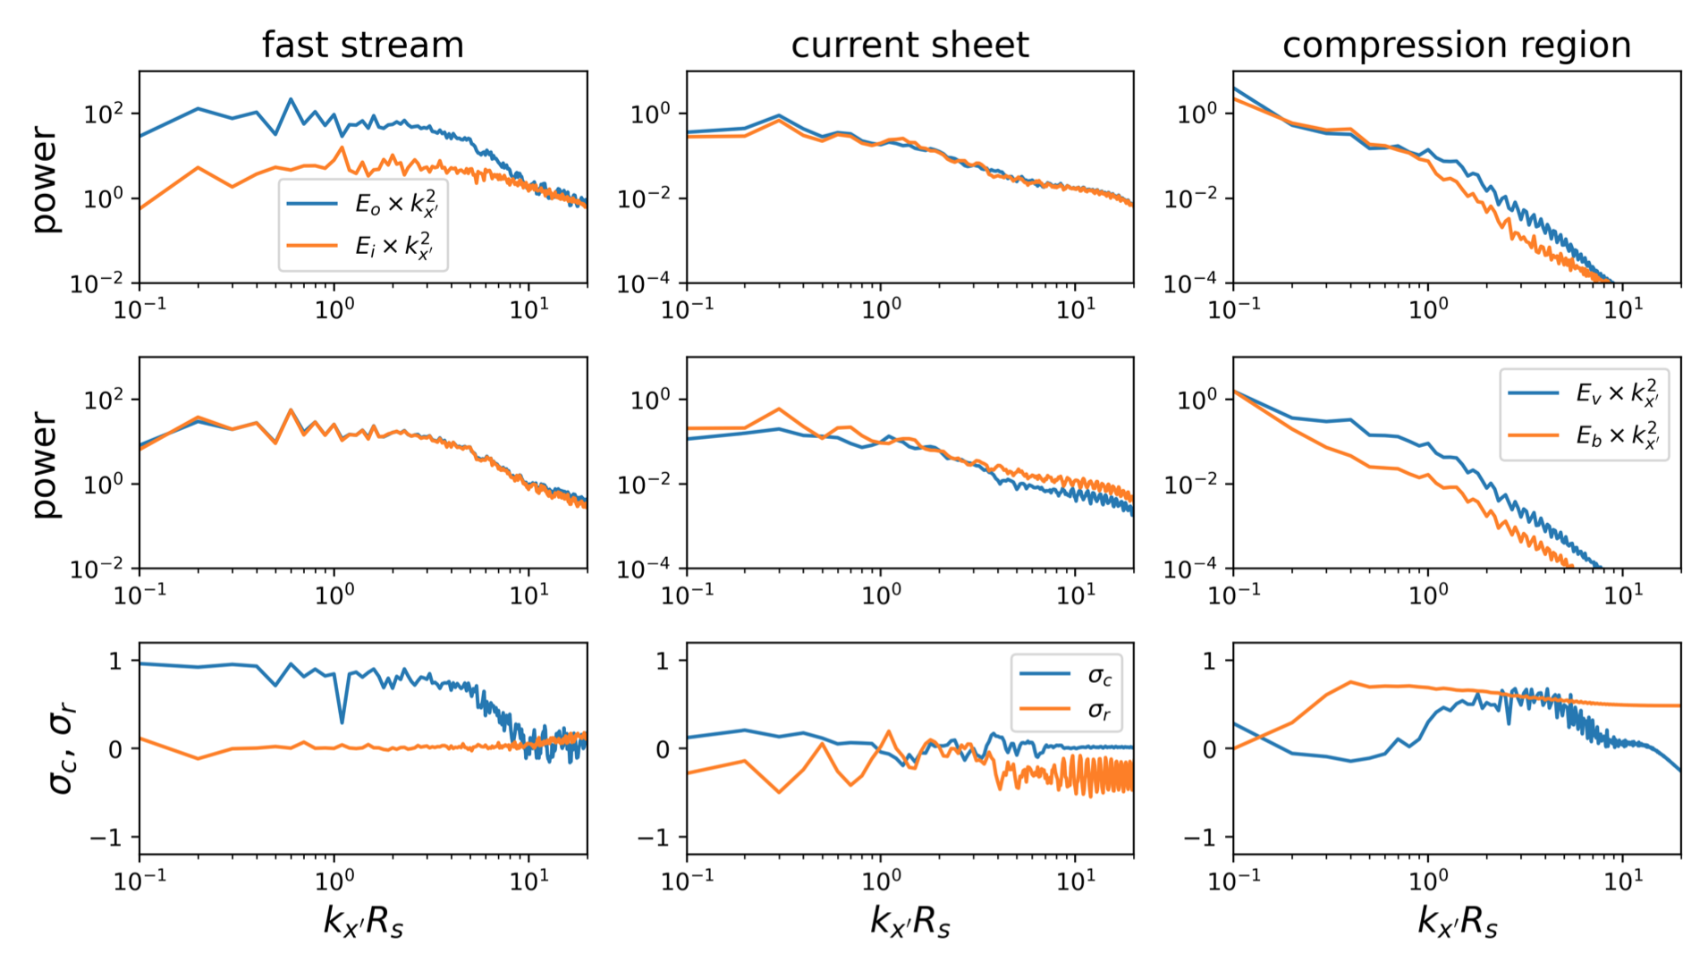



2D EBM-MHD run
$$σ_{c}=\frac{{\left|z_{o}\right|}^{2}−{\left|z_{i}\right|}^{2}}{{\left|z_{o}\right|}^{2}+{\left|z_{i}\right|}^{2}}$$
$$σ_{r}=\frac{{\left|u\right|}^{2}−{\left|b\right|}^{2}}{{\left|u\right|}^{2}+{\left|b\right|}^{2}}$$
Alfvénic
At 1 AU
Non-Alfvénic
outward
Balanced $z^{±}$
inward
Balanced $z^{±}$
More magnetic energy
velocity
magnetic
More kinetic energy
Roberts+1992
Shi+2022

Slide 15
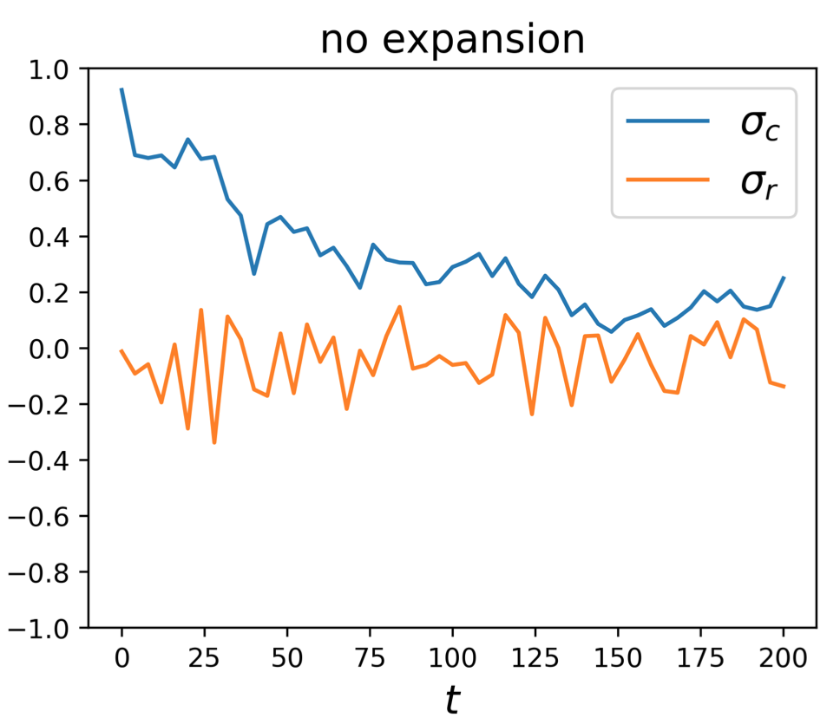
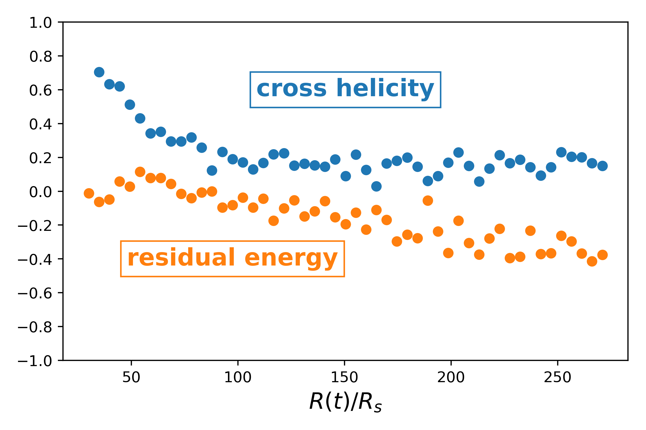

2D EBM-MHD run
Evolution of $σ_{r}, σ_{c}$ around HCS
Expansion effect is necessary for a negative $σ_{r}$

Slide 16

Discussion
SIR
Weakens the dominance of the outward Alfvén wave
Generates an excess of kinetic energy at small scales
Mechanism: generates mainly $δv$ ($δb∼0$), meaning $δz^{+}∼δz^{−}$
HCS
Weakens the dominance of the outward Alfvén wave
Leads to a magnetic energy excess (expansion necessary)
Near the HCS, since $B_{r}∼0$, $δv\&δb$ decouple with each other and expansion leads to: $δv_{⊥}∼\frac{1}{R},\frac{δb_{⊥}}{\sqrt{ρ}}∼1$
Advertisement: (arXiv:1910.02108), (arXiv:2101.00830), (arXiv:2201.02894)

